Slide 1
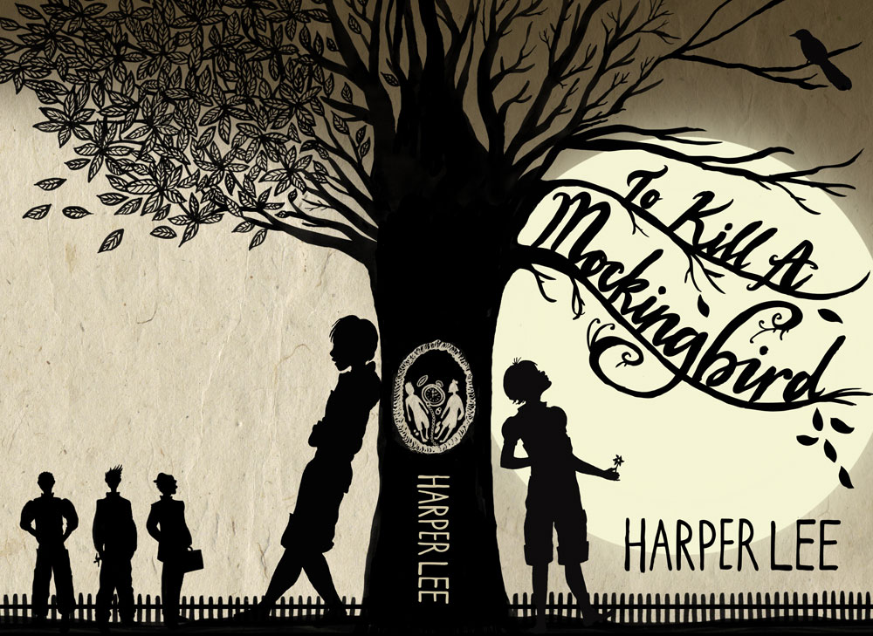
To Kill a Mockingbird
Review

Slide 2
Supporting Characters
Pertinent Characters
Protagonist: Scout
Jem Finch
Atticus Finch
Calpurnia
Boo Radley
Aunt Alexandra
Miss Maudie
Dill Harris
Heck Tate
Mrs. Dubose
Antagonist: Bob Ewell
Mayella Ewell
Tom Robinson
Stephanie Crawford
Mr. Underwood
Miss Caroline
Miss Rachel
Cecil
Mr. Cunningham
Walter Cunningham
Helen Robinson
Judge Taylor
Mr. Gilmer
Dolphus Raymond
Mr. Radley

Slide 3
Character Types
Static Characters: STAY THE SAME
(Exp.: Ms. Maudie, Aunt A, etc.)
Dynamic Characters: CHANGE
(Exp.: Jem, Scout, etc.)

Slide 4
Characterization in the Text
Indirect Characterization
(Example?)
Direct Characterization
(Example?)

Slide 5
Bildungsroman
A literary genre that is built around the coming-of-age of the protagonist or other main characters.
Also called: Coming-of-Age Novel
Characteristics:
→ Growth through loss of innocence
→ Parent or role model (mentor) typically involved
→ Crisis Occurs (& Identity is found)

Slide 6
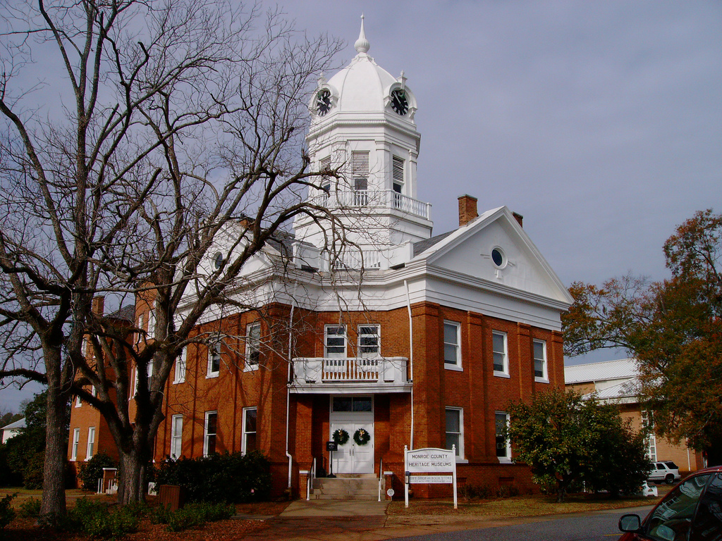
The Setting
Time: 1940s
Place: Maycomb, Alabama

Slide 7
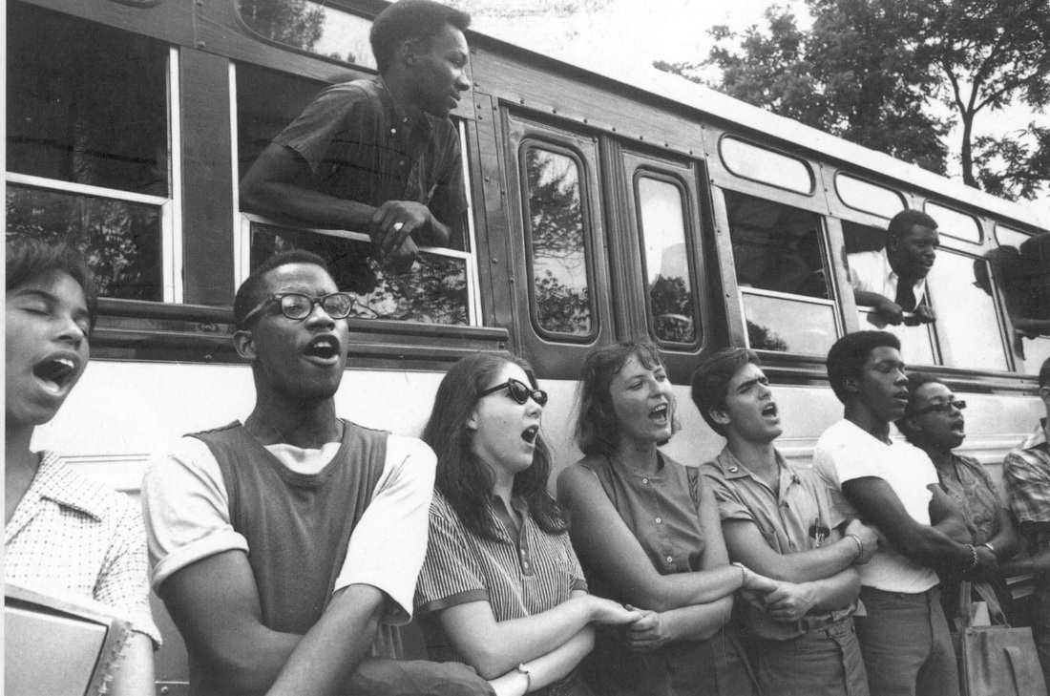
The Publishing
Time: 1960
Significance: Civil Rights Movement

Slide 8
Major Events
First day of school
Boo Radley Game
Tom Robinson Court Case
Church with Calpurnia
The Church Mission Ladies Meeting
The school play
Bob Ewell conflict
Mrs. Dubose event

Slide 9
Protagonist vs. Antagonist
Protagonist= Scout
Antagonist= Bob Ewell

