Slide 1
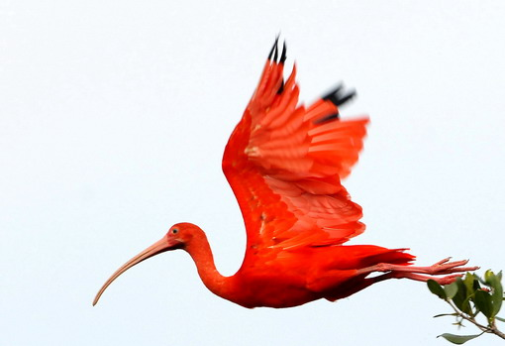
Symbolism

Slide 2
Symbolism
A literary device employed to show a relationship between an object or living thing and a greater idea or abstract concept.
Conventional Symbols- something that is recognized by many people to represent certain ideas (through connotations).
Literary/Contextual Symbols- surpasses the traditional, public meanings; cannot be summarized in a word or two; results when the author or poet creates a deeper and more expansive definition of the symbol employed.

Slide 3
Interpretation
Denotation: the dictionary definition (the historically prescribed definition)
Connotation: the definition given by context, cultural quirks, and society.
Connotations include the stigmas, biases, emotions, viewpoints, imaginative perspectives, and feelings that accompany particular words.
Example: queer, nemo, P.B.R., babe, mustang, Midwest, winter, etc.

Slide 4
Others…
Colors (traditionally & culturally)
Seasons (and associated weather)
Animals (and their natures & abilities)
Elements of Nature (earth, air, fire, water)
Night or Day (and weather during each)
Shapes (Octagons, hearts, diamonds, etc.)
Icons (Logos, Religious Symbols, etc.)

