Slide 1
Romeo & Juliet : Final Review
English 9

Slide 2
TYPES OF PLAYS
Tragedies
Comedies
Histories

Slide 3
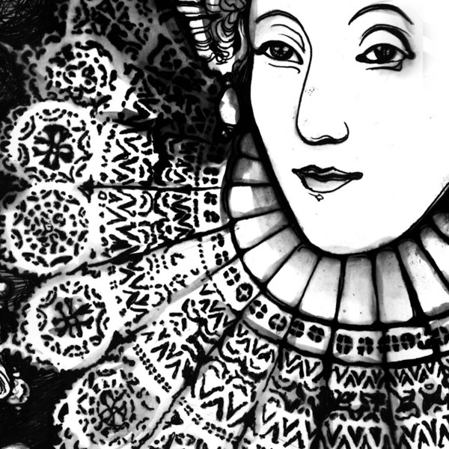
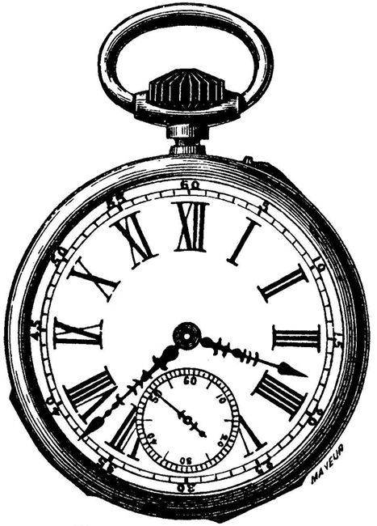
The Timeframe: Elizabethan England
1558-1603

Slide 4
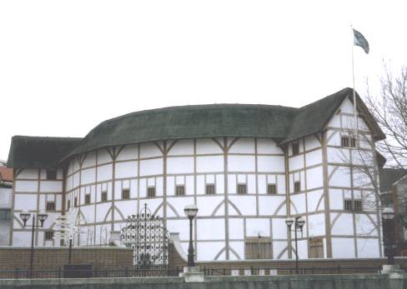
The Globe
Shakespeare’s plays were performed in a theater called the Globe, sometimes called“The Wooden ‘O’” because of its circular shape.

Slide 5
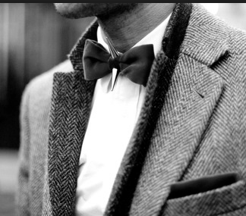
Character Review: The Montagues
Romeo
Montague
Romeo’s
father
Lady
Montague
Romeo’s
Mother
Mercutio
Romeo’s
Friend
Benvolio
Romeo’s
Cousin

Slide 6
Character Review: The Capulets
juliet
Capulet
Juliet’s
father
Lady
Capulet
Juliet’s
Mother
Tybalt
Juliet’s
cousin
Nurse
Juliet’s
nanny

Slide 7
Literary Techniques
Things to know:
Sometimes a character will give a long speech all by herself, revealing her secret thoughts to the audience: this is called a soliloquy.
Sometimes a character will just make a brief comment to the audience that the other characters don’t hear; this is called an aside.
When two characters speak to one another, that is dialogue.
When a word has two meanings, but sounds the same and the author using the chance to play on the words, this is a pun.
When two words are used together, even if they seem contradictory (seem to be opposites), this is a paradox.

Slide 8
Literary Techniques
Things to know:
If a comparison is made using “like” or “as,” this is a simile.
When a comparison is made WITHOUT using “like” or “as,” this is a metaphor.
When an inanimate object is given human qualities, this is called personification.
An inappropriateness of speech resulting from the use of one word for another that closely resembles it is a malapropism.

