Slide 1
Night by Elie Wiesel Review
English 10 Honors

Slide 2
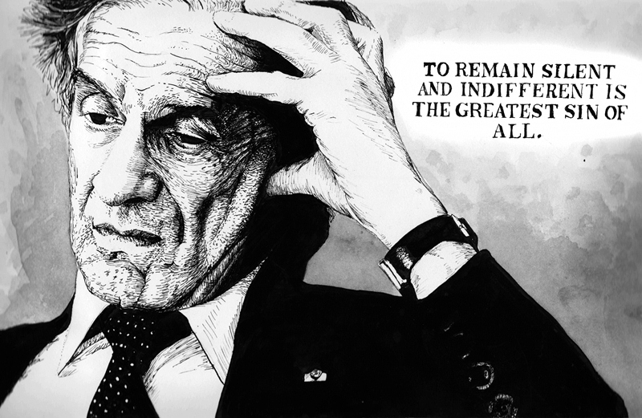
The Author: Elie Wiesel
Elie was deported to Auschwitz with his family in 1944 at the age of fifteen. The members of his Jewish community were arrested on the seventh day of Passover.
He was born in Sighet, Romania, to a Jewish family. He was the only son of four children.
He survived the camps of Birkenau, Buna, Gleitz, and Buchenwald.
In April of 1945, Elie was liberated (making his experience in the concentration camp last for a little under a year).

Slide 3
Night by Elie Wiesel
Non-fiction
Memoir; autobiographical text
Protagonist: Elie Wiesel
Antagonist: Night (the horrors of the Holocaust)
Setting: 1944-45 Concentration Camps in Poland
Tone: Poignant; Sullen
Theme: The Darkness of Human Nature

Slide 4
Remembering the People
Shlomo Wiesel: Elie’s father
Moshe the Beadle: Elie’s spiritual mentor in studying the Kabbalah
Tzipora Wiesel: Elie’s youngest sister who was killed at Auschwitz
Stein: Elie’s relative who is looking for his family at the concentration camp
Juliek: the young violinist crushed beneath the masses
Mrs. Schächter: the woman on the train who saw fire before the arrival at Auschwitz
Franek: the foreman whose greed led him to beat Elie’s father for the gold cap
Zalman: the boy killed in the final death march; crushed by everyone
Idek: the cruel leader who whips and beats Elie

Slide 5
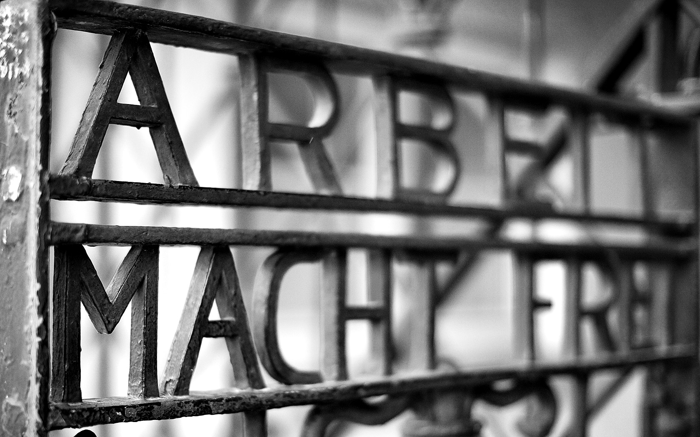
World War II & The Holocaust
World War II, Hitler’s reign, and the horrors of the Holocaust lasted from 1941-1945.

Slide 6
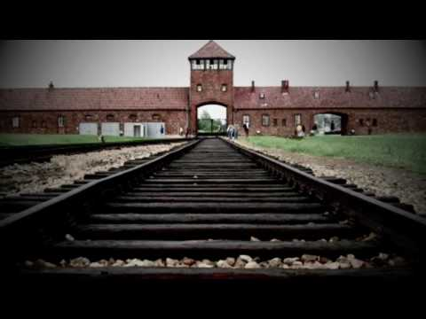
Auschwitz
Auschwitz was the largest concentration camp. It was comprised of three camps: Birkenau (the point of arrival), Buna (the work camp), and Monowitz (the torture center).
Between 1940 and 1945, 1.1 million of the 1.3 million Jews were murdered.

Slide 7
Poignant Parts of the Text
The First Ghetto on Serpent Street
Mrs. Schächter’s fire prophecy
The arrival at Auschwitz: “Men to the left, women to the right.”
The process.
Stein from Antwerp and the lie
The gold crown greed
The Beating & the words of the French girl
The Lashes for witnessing Idek with a girl
The hanging of the sad-eyed angel
The Infirmary Visit

Slide 8
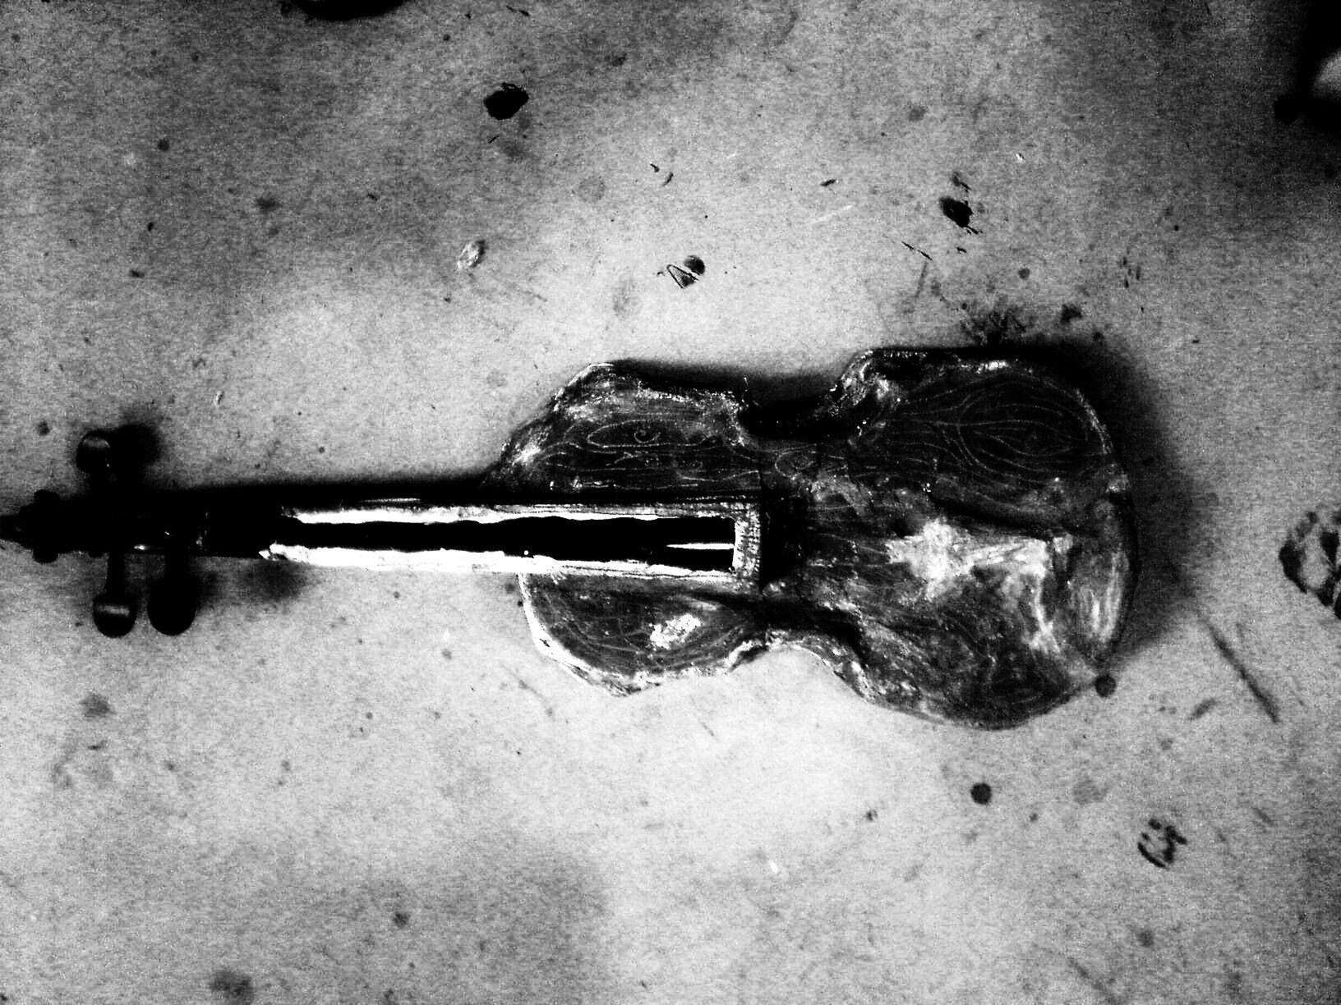
Poignant Parts of the Text: Continued
The Death March
Juliek and Beethoven
The Bread Crust
The Death of Elie’s Father
Bread, Not Revenge
The Reflection of a Corpse

Slide 9
Literary Device: Symbolism
Symbol: something that stands for or represents something else
Night: The darkness of the events of the Holocaust
Fire: Destructive Power
Serpent Street: A foreshadowing of evil
Fleshy Lips: The evil side of human nature and the exploitation of verbal abuse upon the Jewish people
Seven Seals: The end times
The Gold Crown: A symbol of human greed and self-centricism.

Slide 10
Literary Device: Comparison
Simile: comparison using like or as
Textual Example:
Metaphor: comparison between two unlike things
Textual Example:
Conceit: an elaborate metaphor
Textual Example:

Slide 11
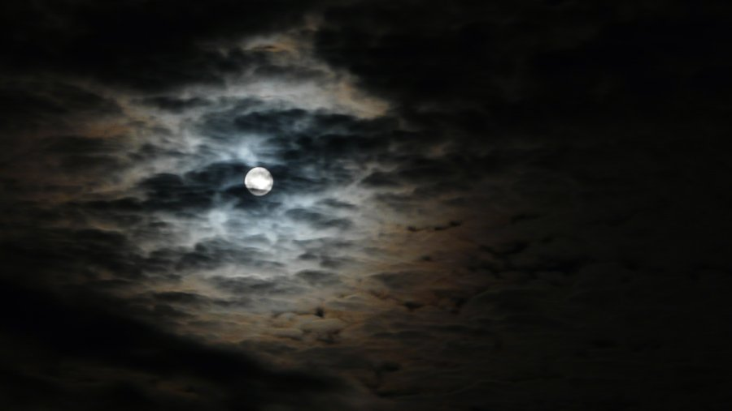
Literary Device: Personification
Personification: representing an abstract quality or idea as a person or creature.

Slide 12
Literary Device: Foreshadowing
Foreshadowing: the use of hints and clues to suggest what will happen later in a plot
Moshe the Beadle’s return and warnings.
Serpent Street in the first ghetto.
Mrs. Schächter’s Prophecy.

Slide 13
Literary Device: Imagery
Imagery: when the writer or speaker uses their descriptions to access the senses of the reader or listener

Slide 14
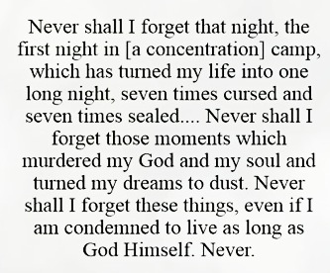
Literary Device: Anaphora
Anaphora: literary technique in which the same word or phrase is used in repetition at the commencement of each subsequent line.
“Never shall I…”

Slide 15
Social Psychology
In the 1960s, social psychologists began conducting experiments to see if the cruelty and the extent of darkness in human nature was only due to the “German” line.
Milgram's “Shocking Experiment” showed that 2/3rds (67%) of the participants would conform to killing a participant in the study merely for incorrectly answering questions.
Zimbardo’s “Stanford Prison Experiment” showed the dark nature of people when placed in a powerful position with limited authoritarian supervision and guidance.

Slide 16
Thematic Awareness
Guilt & Inaction
Dehumanization
Altruism
Survival of the Fittest
Control, Power, & Conformity
Darkness of Human Nature
Father & Son Bond
Death
Moral Conviction
Spiritual Doubt
Silence
Injustice

Slide 17
Quotes
“’There are a thousand and one gates allowing entry into the orchard of mystical truth. Every human being has his own gate. He must not err and wish to enter the orchard through a gate other than his own gate. That would present a danger not only for the one entering but also for those who are already inside’” (Wiesel 5).
Years later, I witnessed a similar spectacle in Aden. Our ship’s passengers amused themselves by throwing coins to the “natives,” who dove to retrieve them. An elegant Parisian lady took great pleasure in this game. When I noticed two children desperately fighting in the water, one trying to strangle the other, I implored the lady: ‘Please, don’t throw any more coins!’ ‘Why not?’ said she. ‘I like to give charity…’” (Wiesel 100).

Slide 18
Quotes
“’Have faith in life, a thousand times faith. By driving out despair, you will move away from death. Hell does not last forever… And now here is a prayer, or rather advice: let there be camaraderie among you… Good night.’” (Wiesel).
“‘Bite your lips, little brother…Don’t cry. Keep your anger, your hate, for another day, for later. The day will come but not now… Wait. Clench your teeth and wait…” (Wiesel).

Slide 19
Quotes
“He tried to calm them, to reassure them about their fate, to explain to them that staying in the camp did not mean much, had no tragic significance: ‘After all, I stay here every day…’ The argument was more than flimsy. He realized it and, without another word, locked himself in his room” (Wiesel 74).
“From the depths of a mirror, a corpse was contemplating me. The look in his eyes as he gazed at me has never left me” (Wiesel 115).

