Slide 1
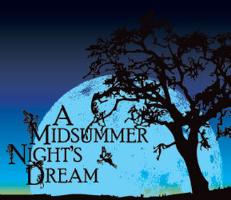
A Mid-Summer Night’s Dream
English 10H | Review Session

Slide 2
TYPES OF PLAYS
Tragedies
Comedies
Histories

Slide 3
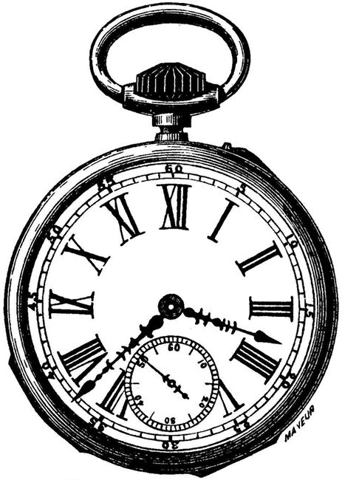
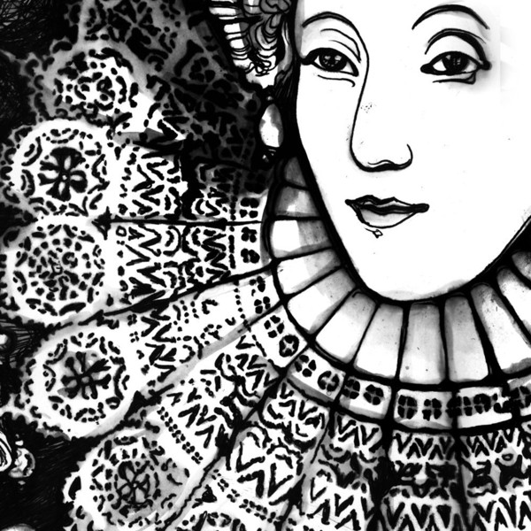
The Timeframe: Elizabethan England
Know the backstory of “the mermaid on a dolphin’s back” and the backstory of Queen Elizabeth and Robert Dudley.
1558-1603

Slide 4
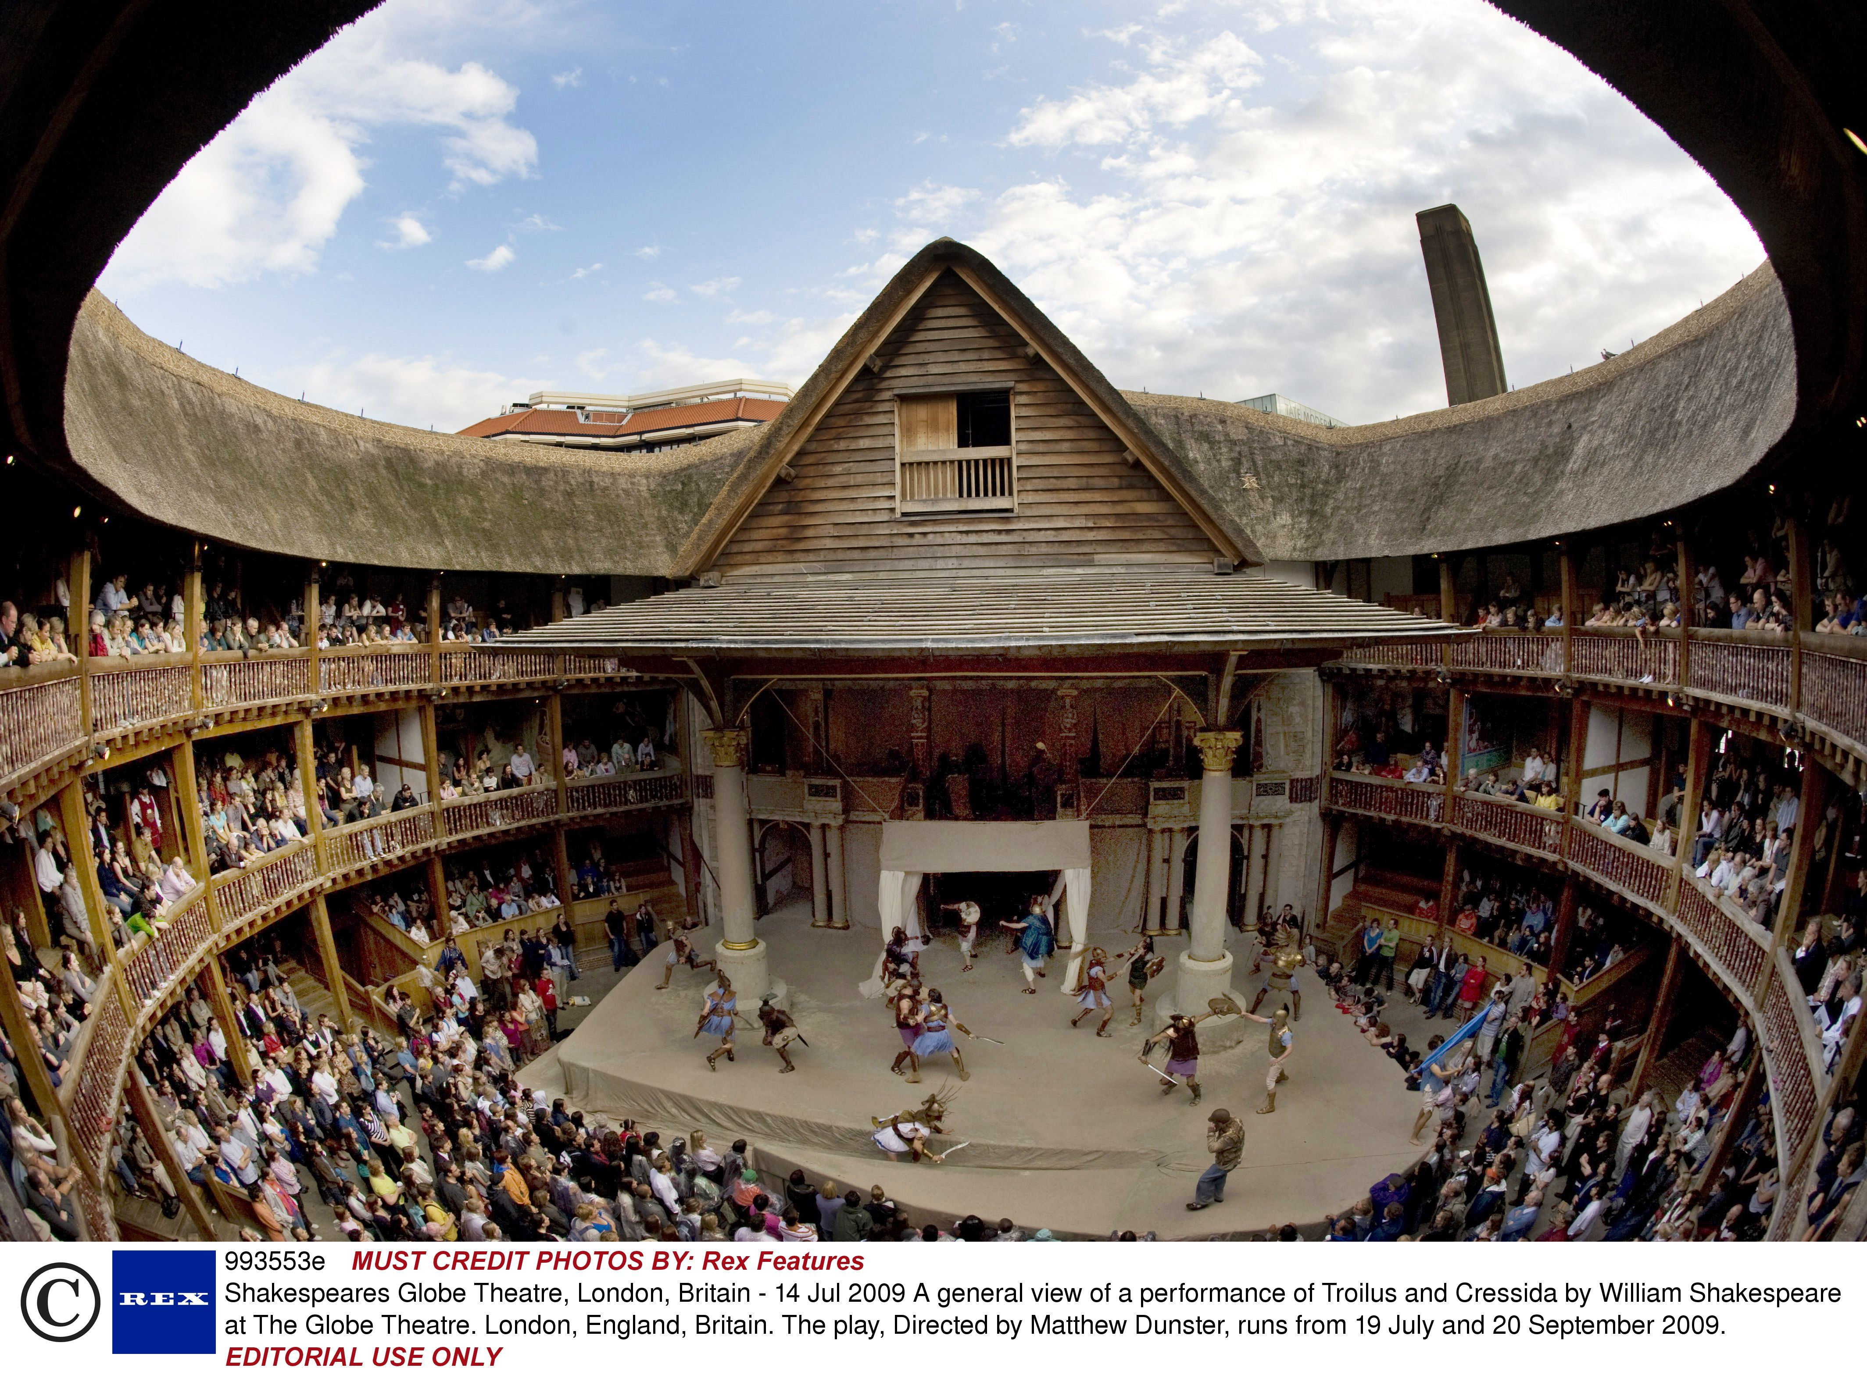
Shakespeare & The Globe Theatre

Slide 5
Sonnet 18
“Shall I compare thee to a summer’s day?”
Understand who he wrote it for.
What is the message?
Know the sonnet rhyme scheme (ABAB CDCD EFEF GG). What are the groups of four called? What are the last two lines called?
How many lines total are in a Shakespearean sonnet?

Slide 6
The Athenians: Character Review
Theseus: Duke of Athens
Hippolyta: Former Queen of the Amazon; marrying Theseus
Egeus: Hermia’s overbearing father
Hermia: in love with Lysander
Lysander: initially in love with Hermia (while under the influence is in love with Helena)
Demetrius: rejects Helena and pursues Hermia (while under the influence is in love with Helena)
Helena: jealous of her best friend (Hermia); in love with Demetrius even though he does not love her back

Slide 7
The Workmen: Character Review
Peter Quince: leader of the play
Nick Bottom: Pyramus in the play; arrogant character who gets turned into a partial donkey
Tom Snout: plays the wall in the play
Snug: plays the lion in the play
Francis Flute: plays Thisbe in the play
Philostrate: in charge of events
Robin Straveling: plays moonshine in the play

Slide 8
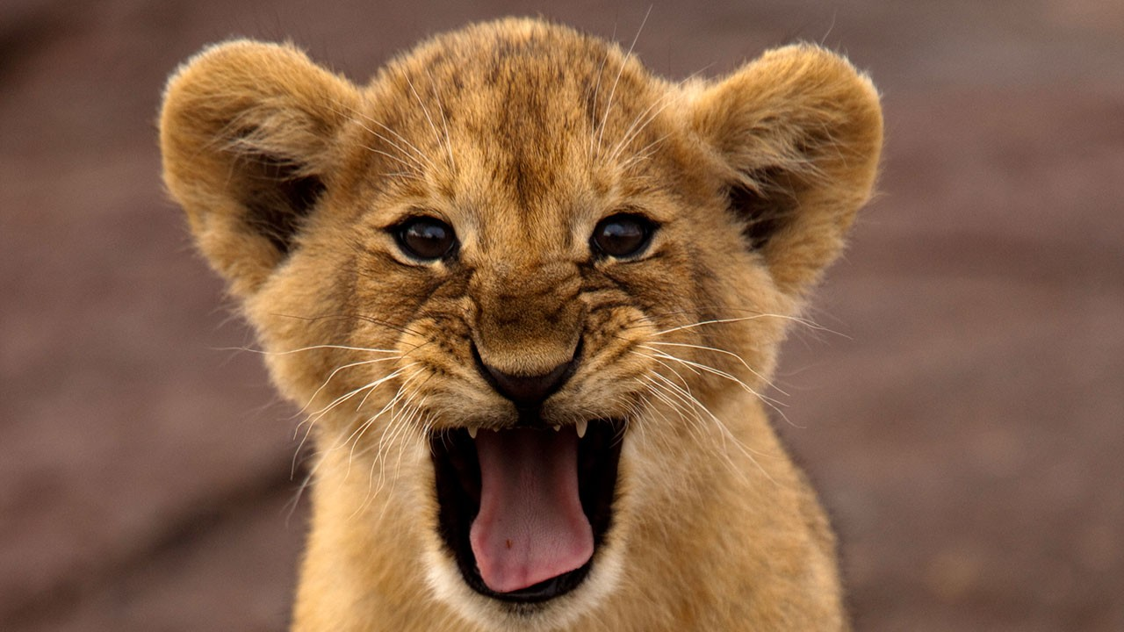
The Tale of Pyramus & Thisbe
Two lovers- forbidden love- neighbors- earthquake-crack in wall- game plan- Thisbe first- forgets coat- sees lion with blood- drops coat- blood on coat- along comes Pyramus- sees blood on Thisbe’s coat- kills himself- Thisbe returns- sees Pyramus- kills herself too.
Moral: Never go back for your coat. Never leave your coat near a lion. Never fall in love with your neighbor.
Notes:
http://www.bbmpsportsnetwork.com/wp-content/uploads/2015/11/Lion.jpg

Slide 9
The Fairies: Character Review
Oberon: King of the Fairies
Titania: Queen of the Fairies
Puck (Robin Goodfellow): Oberon’s servant; trickster
Indian Boy: a reason for Oberon & Titania to fight
Mote, Mustardseed, Peaseblossom, & Cobweb: Titania’s fairies

Slide 10
Literary Terms
Dramatic Irony- occurs when the audience is aware of something that the rest of the characters are not aware of… yet.
Soliloquy- a long speech given directly to the audience that reveals the thoughts and feelings of the character/actor
Aside- a short side comment to the audience or another character
Hyperbole- extreme exaggeration
Simile- a comparison using like or as

Slide 11
Literary Terms
Metaphor- a comparison that avoids using like or as
Pun- a play on words; when words have more than one meaning
Mimesis- to recreate something with a twist- removing it from its original form and production
Monologue- a speech that a character makes that is NOT directed to the audience
Archetype- a prototypical person, place, thing, event, or theme that is reiterated throughout literary history
Notes:
https://quizlet.com/_1yi248
https://app.nearpod.com/#/?pin=YZSRP

