Slide 1
Kindred
Octavia Butler

Slide 2
Kindred Spirits
What are “kindred spirits?” Are they the same as a soul mate? Do you believe in soulmates, destiny, fate?
Find a partner and discuss the question…

Slide 3
Why the title Kindred?
first used p. 57 “kindred spirit”
Kinship, kindness, similarity, relationship, connection
Pun: “kin-dread”—fear of relatives, ancestors
Plot: Dana reluctantly discovers her ancestry, which includes whites, as well as, enslaved Africans.
Dana’s kindness is evident in many scenes (such as in first saving the young Rufus from drowning
Dana’s light skin and educated speech are seen as her kinship with white people, one of whom she has married
Black and white folks are kin—deconstructing the myth of separate “races”—and dependent on one another for survival

Slide 4
Why We Are Reading This:
“I'm comfortably asocial — a hermit living in a large city — a pessimist if I'm not careful; a student, endlessly curious; a feminist; an African American; a former Baptist; and an oil and water combination of ambition, laziness, insecurity, certainty, and drive.”-Octavia Butler
To understand the institution of slavery, the ideologies that perpetuate the institution, the history of human enslavement, and the connection to contemporary forms of enslavement today.

Slide 5
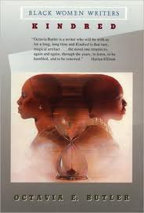
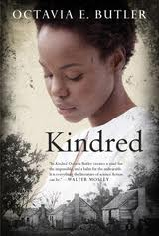
Take a minute to respond to these 3 different edition covers of Kindred. What do you see in each of them?

Slide 6
A Female Protagonist
“Actually, I began with a man as main character, but I couldn't go on using the male main character, because I couldn't realistically keep him alive. So many things that he did would have been likely to get him killed … The female main character, who might be equally dangerous, would not be perceived so. She might be beaten, she might be abused, but she probably wouldn't be killed and that's the way I wrote it. She was beaten and abused, but she was not killed. That sexism, in a sense, worked in her favor. … But, anyway, that's a long-winded answer. And that's how I came to write Kindred.”

Slide 7
Tale of Two Settings
From sea to shining sea… What are the two settings of the novel?

Slide 8
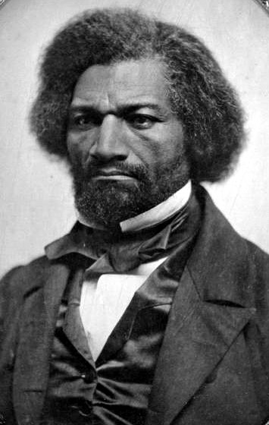
Weylin Setting: Maryland
Talbot County Maryland
Home of the young Frederick Douglass, whose Narrative of the Life of an American Slave (1845) is the most famous slave narrative
Serves as a source for most of the details in the novel

Slide 9
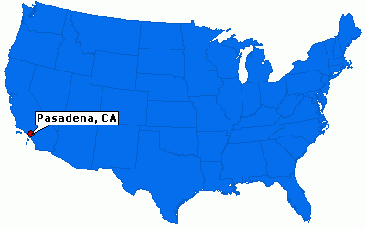
Contemporary Setting
Pasadena, California
Time of the novel: June-July 4, 1976
America’s Bicentennial, anniversary of the Declaration of Independence
Are all men (and women) treated equally as the Declaration promises?

Slide 10
Key Themes
Race as a social construct
Trauma and Historical Memory (Historical Amnesia)
American Myopia
Power Dynamics
Education as a subversive act
Sex and Gender Inequality
Slavery (Now Versus Then)
Patriarchy
White Supremacy and White Privilege
Black Community
Survival
Normalization
Redemption
Concept of “Home”

Slide 11
The Time Travel
Rufus born about 1805
“The River” (about 1811)
“The Fire” (1815)
“The Fall” (1819)
“The Fight” (1824)
“The Storm” (1830-1831)
“The Rope” (1831)

Slide 12
Historical Fiction
As many of you mentioned, the key difference between this novel and stereotypical science fiction pieces is the aspect of historical reality. It takes the novel from the fictionalized world and scaffolds the reader to make a deeper connection.

Slide 13
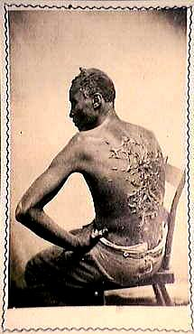
According to the Fourth of July 1863 Harpers Weekly, "McPherson and Oliver of Baton Rouge, La." distributed this carte de visite photograph of "Gordon" who escaped from his master in Mississippi, "his back furrowed and scarred with the traces of a whipping administered on Christmas day."

Slide 14
Historical Context
1819 Missouri Compromise
Rebellions and Abolitionists
1811 Charles Deslondes
1822 Denmark Vesey
1831 William Lloyd Garrison
1863 Emancipation Proclamation
1865-1877 Reconstruction/Jim Crow Laws
1964 Civil Rights Act
1965 Voting Rights Act
Black Power Movement
Black Panther Party, October 1966, Oakland

Slide 15
Quick Activity: Recognizing Faces
Understanding American Mytopia…
You will be shown a collection of photographs of people who have made an impact in history.
On a scrap piece of paper, write that individual’s name down and a word or two on their contribution to history.

Slide 16
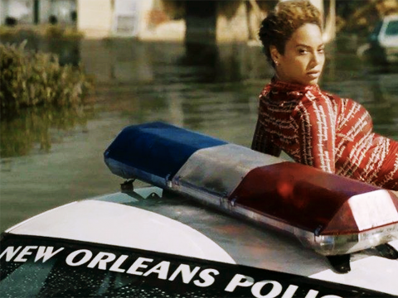
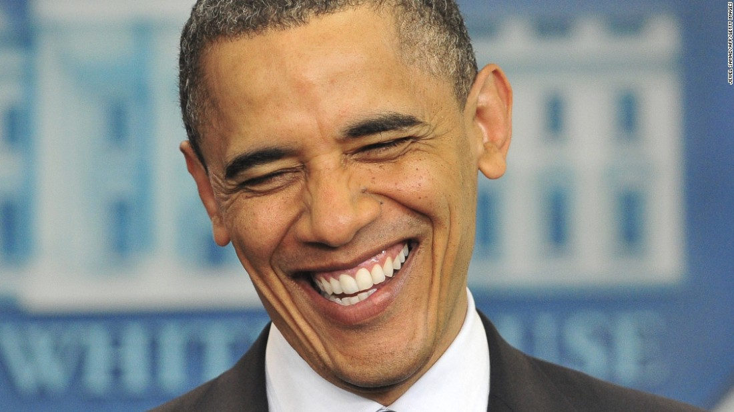
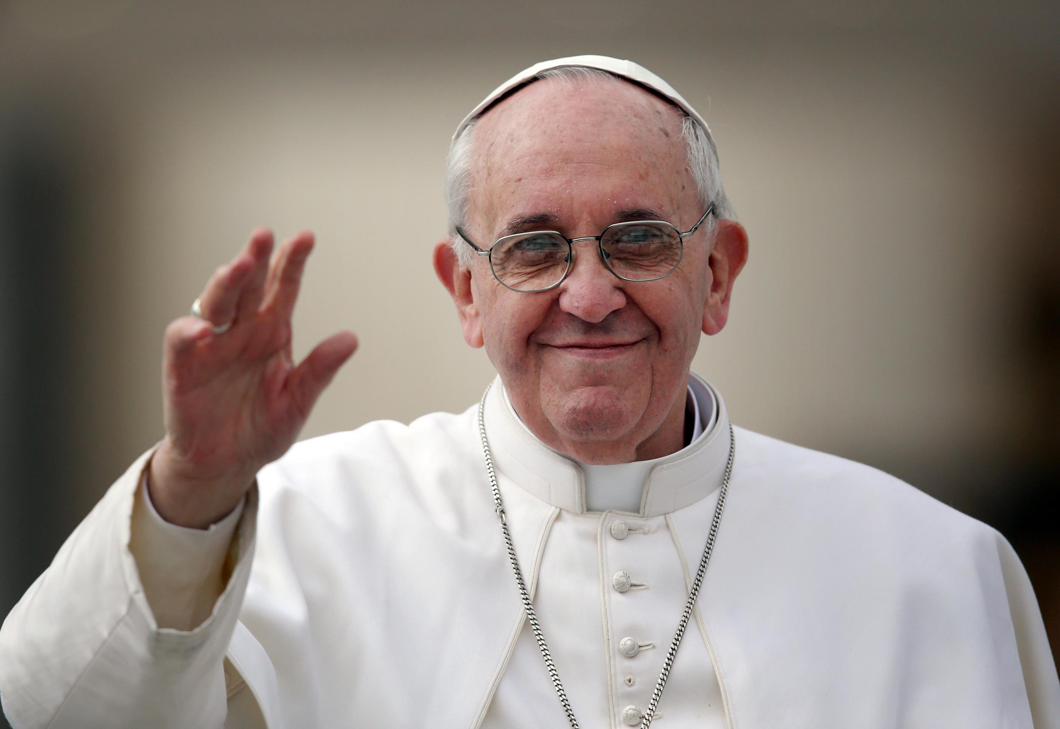
Name These People
1.
3.
2.
4.

Slide 17
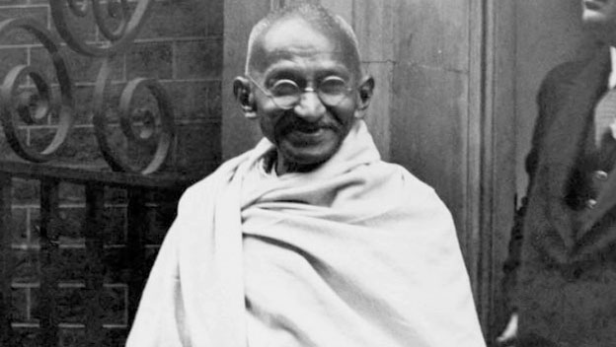
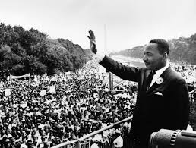
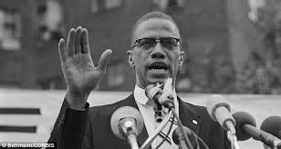
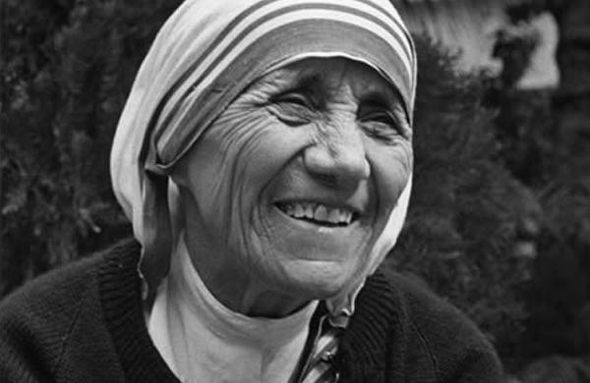
Name These People
5.
7.
6.
8.

Slide 18
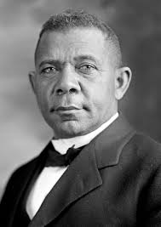
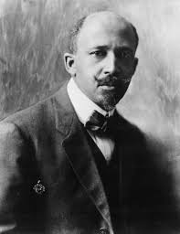
Name These People
9.
10.

Slide 19
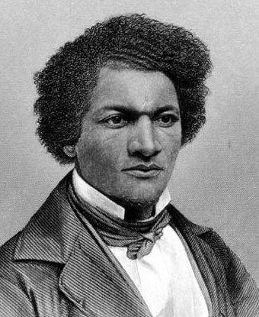
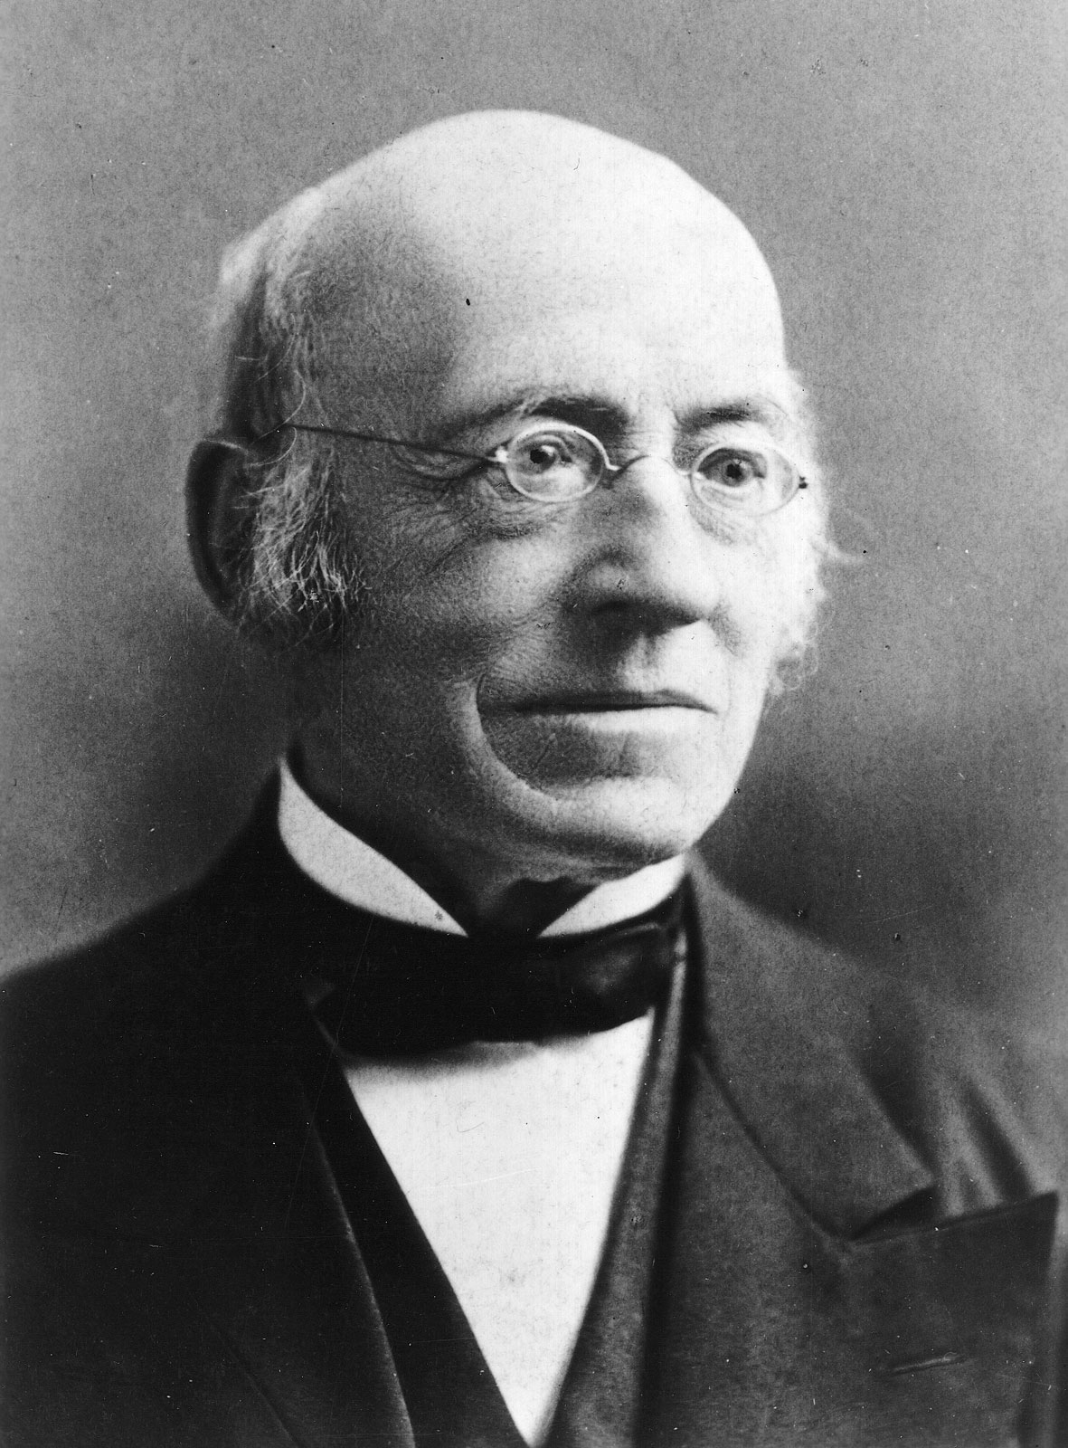
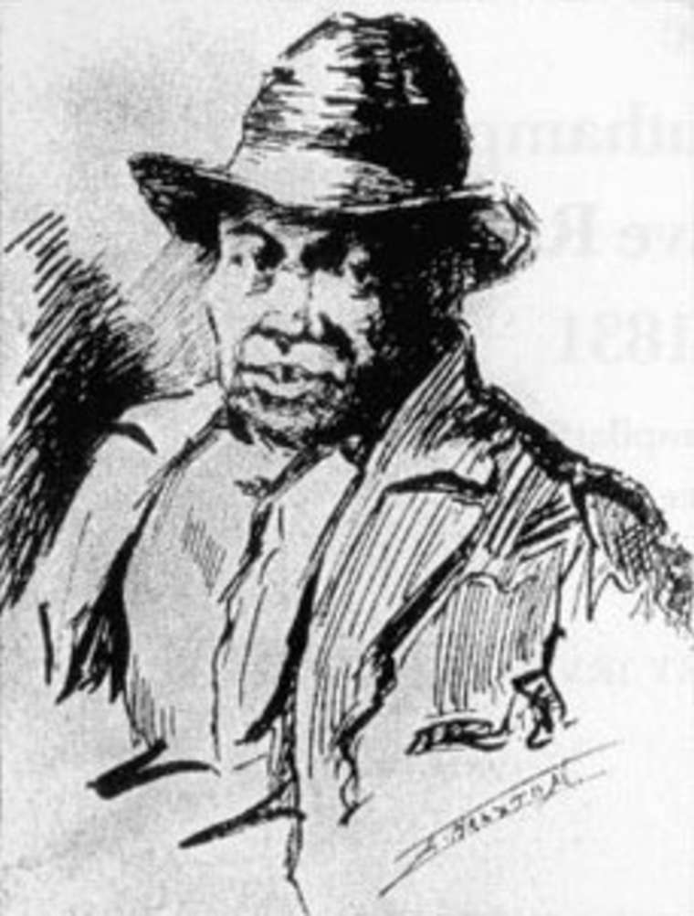
Name These People
11.
12.
13.

Slide 20
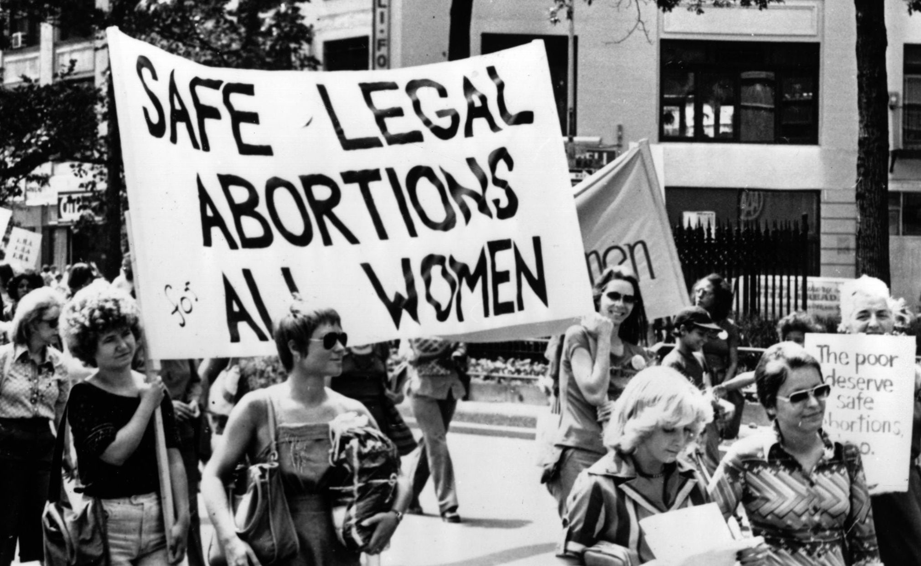
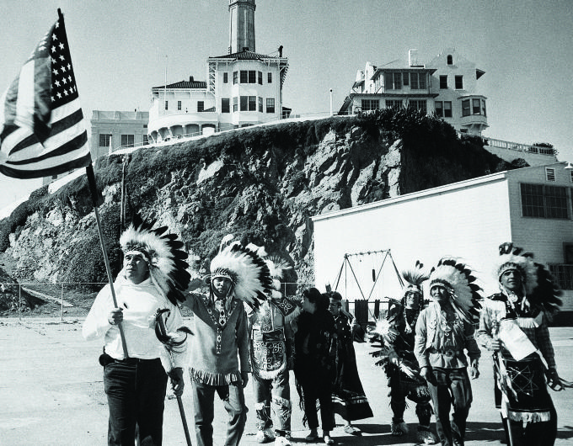
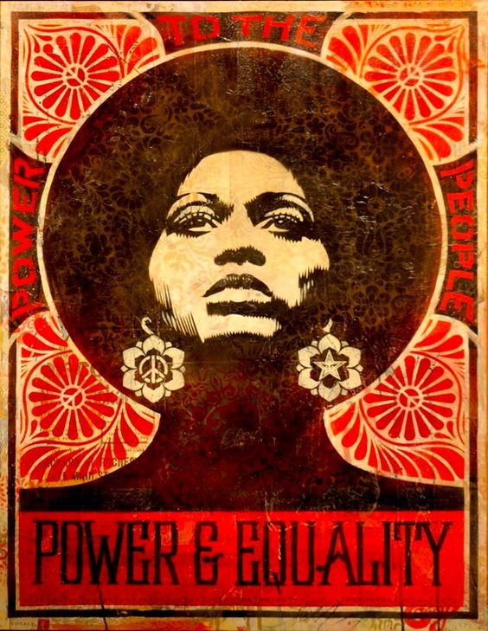
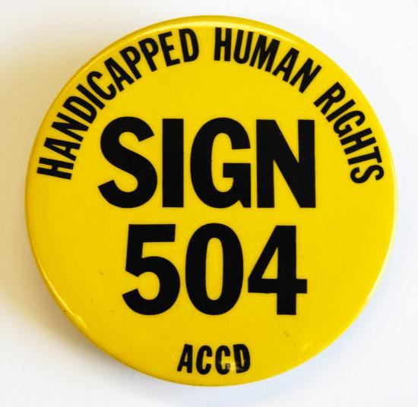
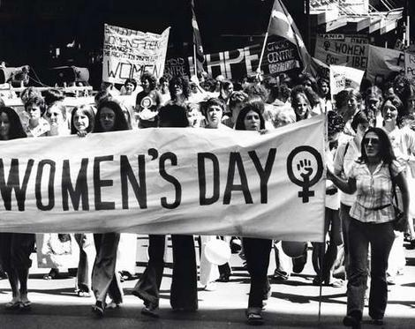
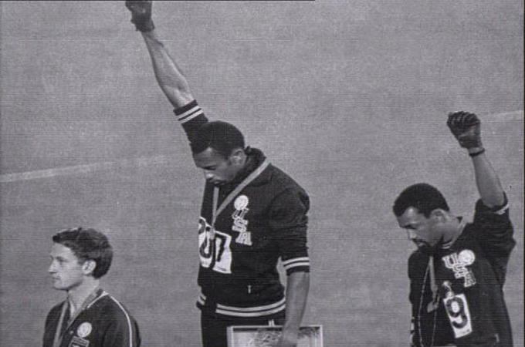
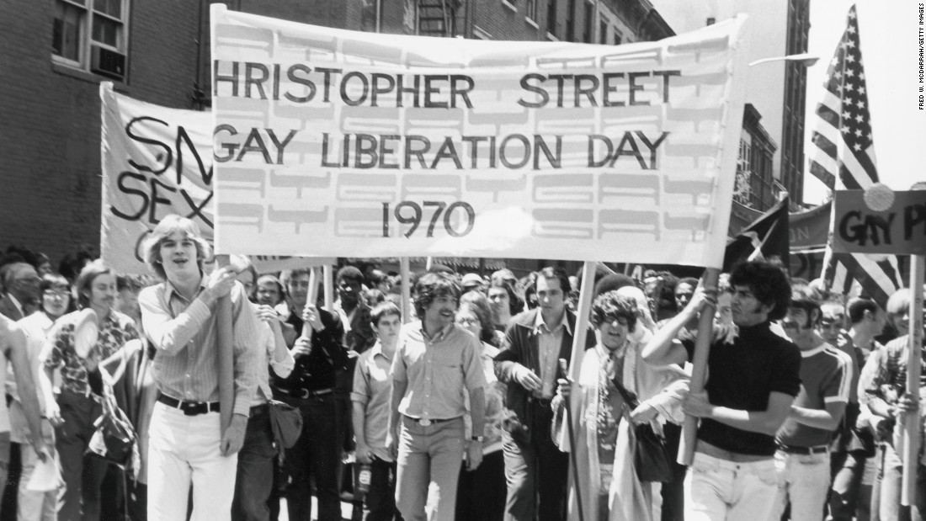
Leading Up to 1976

