Slide 1
Kindred
Octavia Butler

Slide 2
Key Themes
Race as a social construct
Trauma and Historical Memory (Historical Amnesia)
American Myopia
Power Dynamics
Education as a subversive act
Sex and Gender Inequality
Slavery (Now versus Then)
Patriarchy
White Supremacy and White Privilege
Black Community
Survival
Normalization
Redemption
Concept of Home

Slide 3
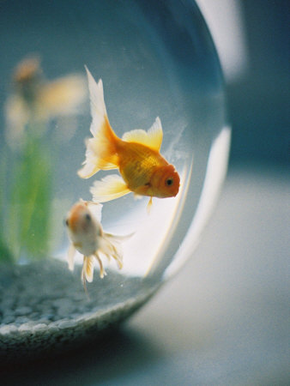
Fishbowl Socratic Seminar
Directions:
Find groups of five.
In your group, answer the discussion questions regarding the key themes in Kindred. Just ANSWER… You do not have to write it all out.
As you are discussing, I will circulate around the room and assign a number (1-5) to you.
Then, during our whole class discussion, the group of ones will discuss first, group of twos second, and so forth…

