Slide 1
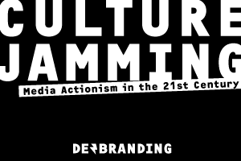

Slide 2
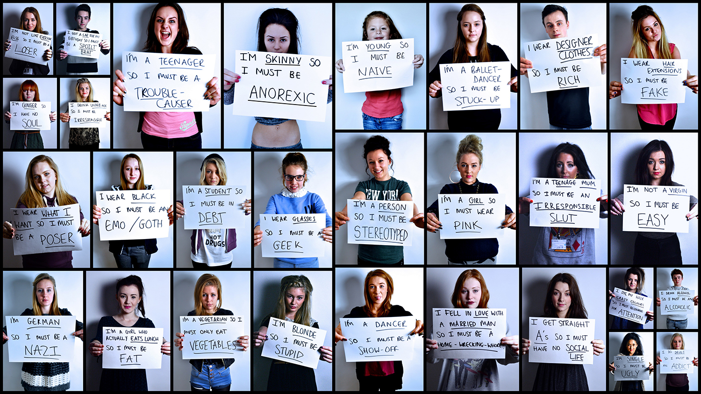
PERCEPTION

Slide 3
Labels

Slide 4
Culture
High Culture: cultural practices, materials, and behaviors that society has deemed elitist
Low Culture: cultural practices, materials, and behaviors that society has deemed “lower or middle class”
Pop Culture: mass culture available to and marketed to a large variety of people

Slide 5
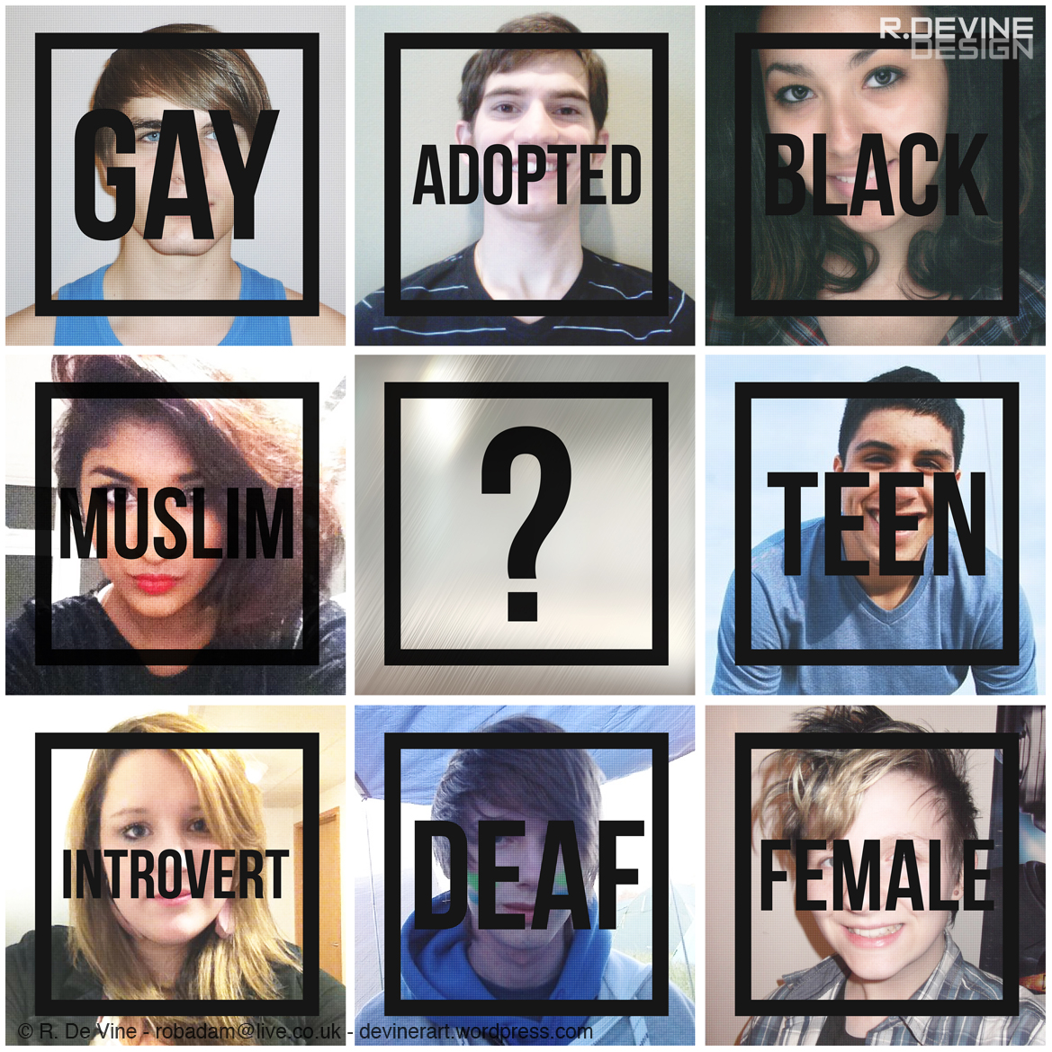
Ideologies & Connotations
Ideologies: conceptual frameworks that are embedded into the practices and belief systems inherent in our society.
Connotations: the cultural definition given to words or phrases by society

Slide 6
Literacies
Literacy: a medium through which a message is elicited to a particular audience.
Examples: music, lyrics, books, short stories, poems, genres, receipts, newspapers, photographs, text messages, bill boards, menus, paintings, sculptures, magazines, license plates, posters, flyers, podcasts, videos, movies, film clips, etc.

Slide 7
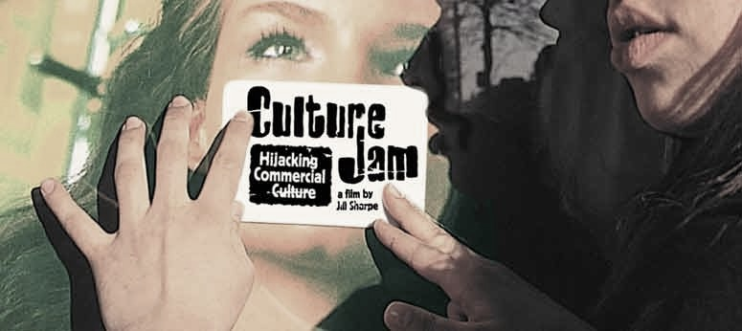
Culture Jamming
Culture Jamming: the process of using mass produced and socially recognizable images with particular and popular connotations and in a subversive way manipulating these images to create different connotations that offer a different perspective or critique of society.

Slide 8
Archetypal Criticism
Archetypal Criticism: a critical lens that looks at archetypes to explain how we interpret literacies.
Archetype: thematic prototypes (redundant symbols, clichés, themes, images, etc.)
Carl Jung’s Collective Consciousness

Slide 9
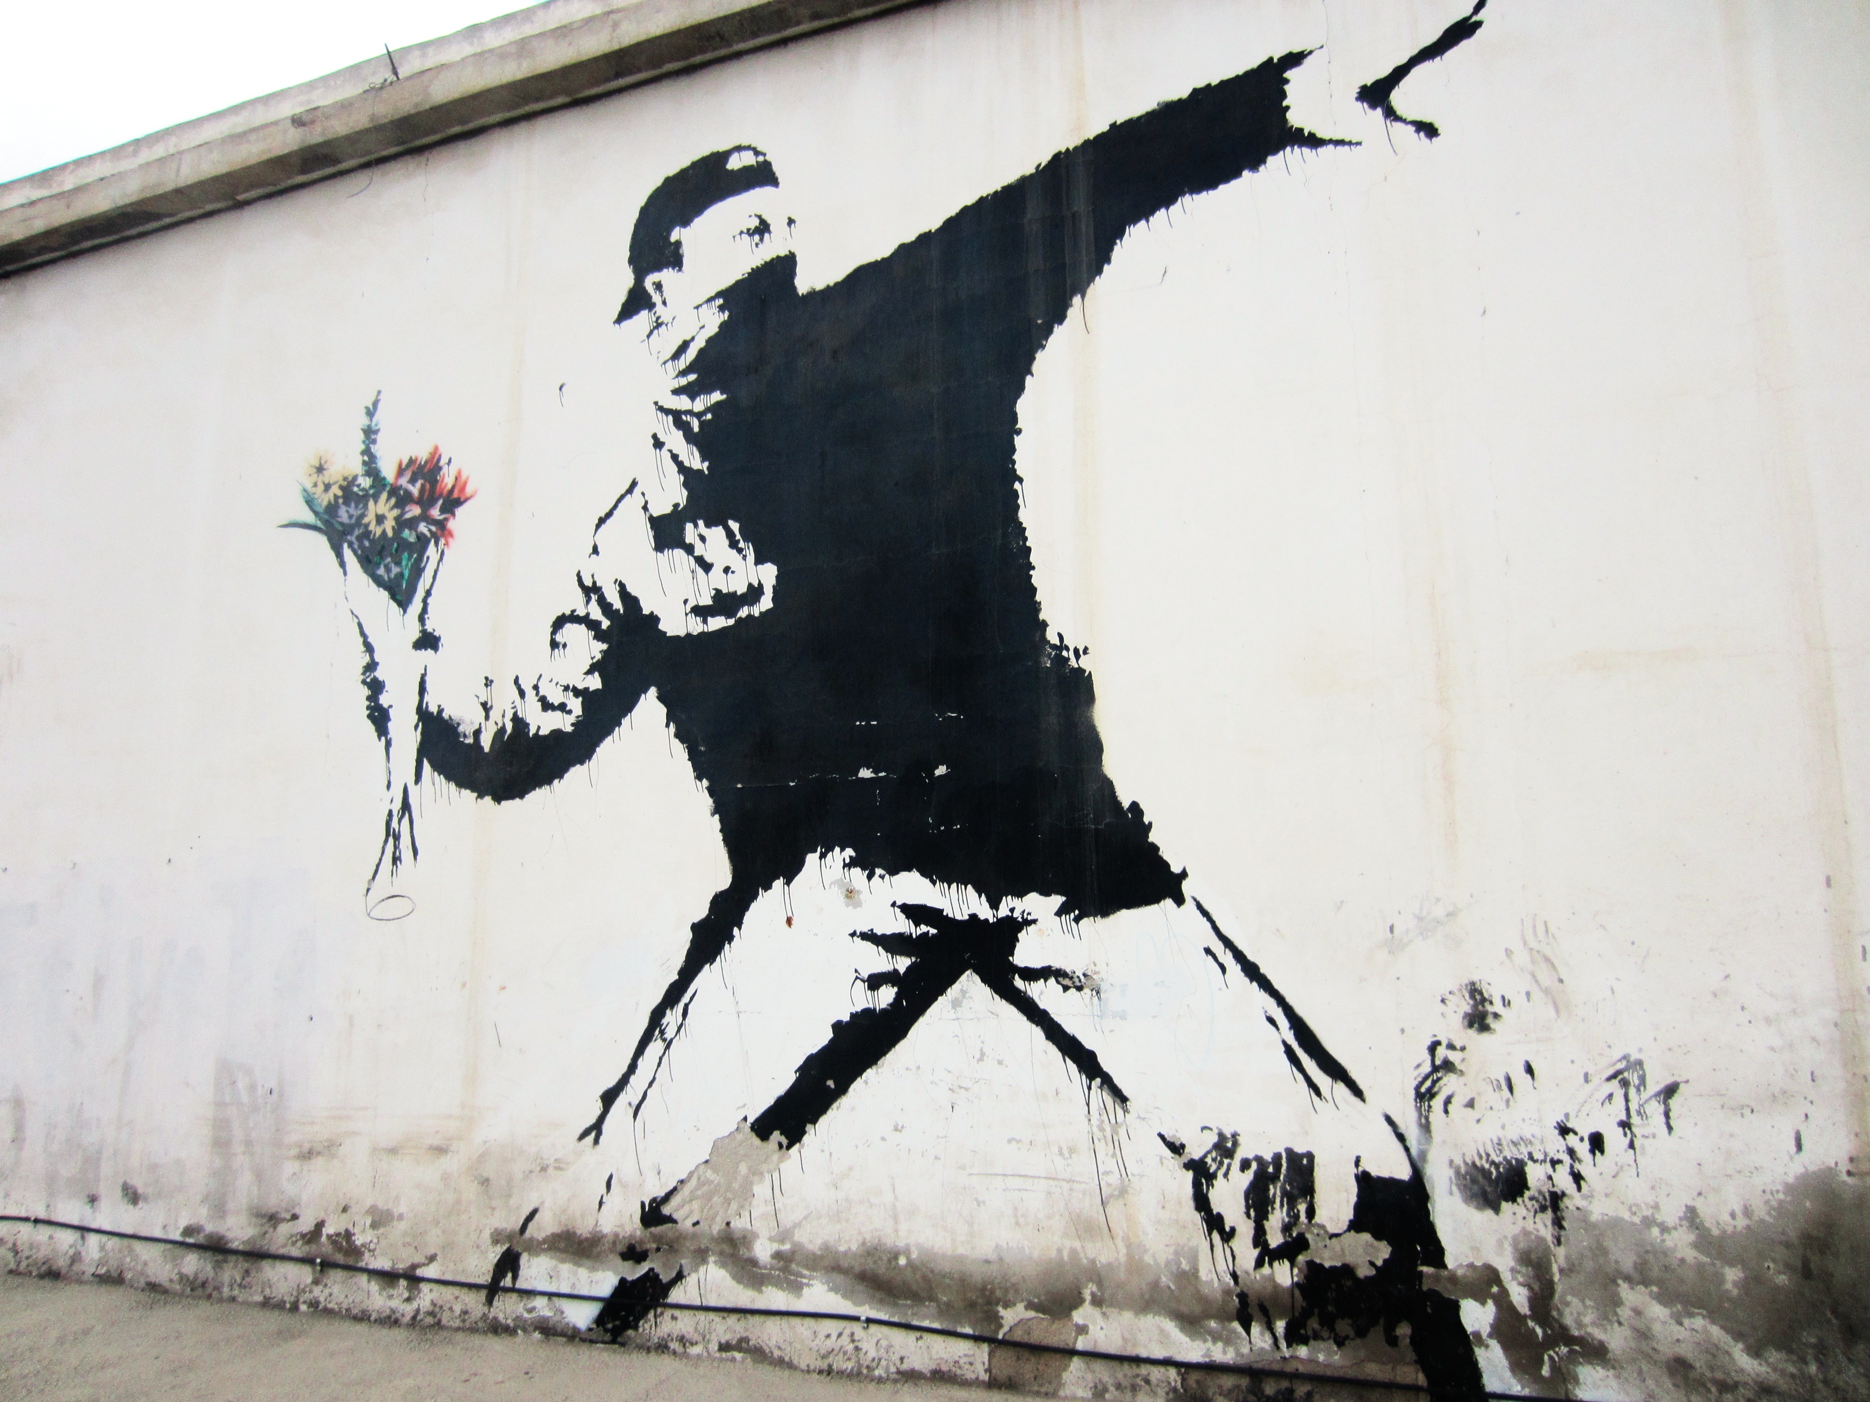
Banksy Art

Slide 10
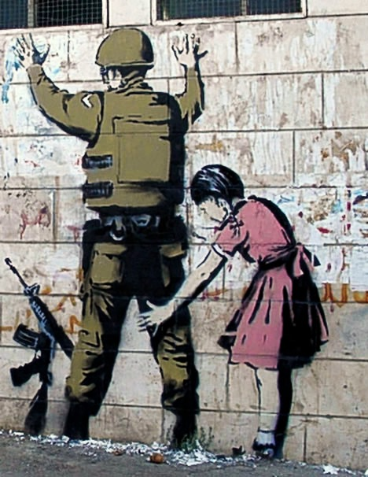

Slide 11
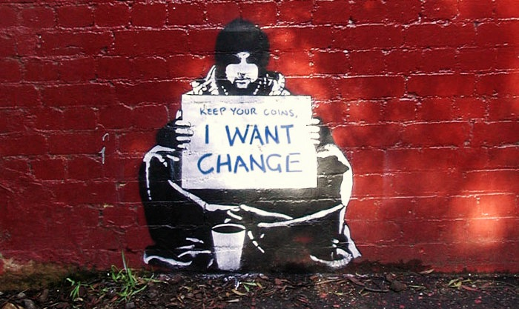

Slide 12
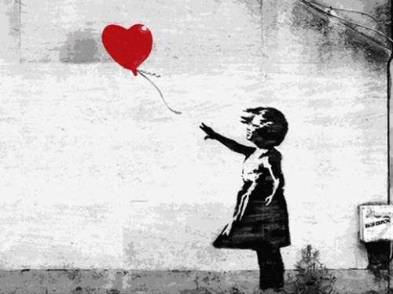

Slide 13
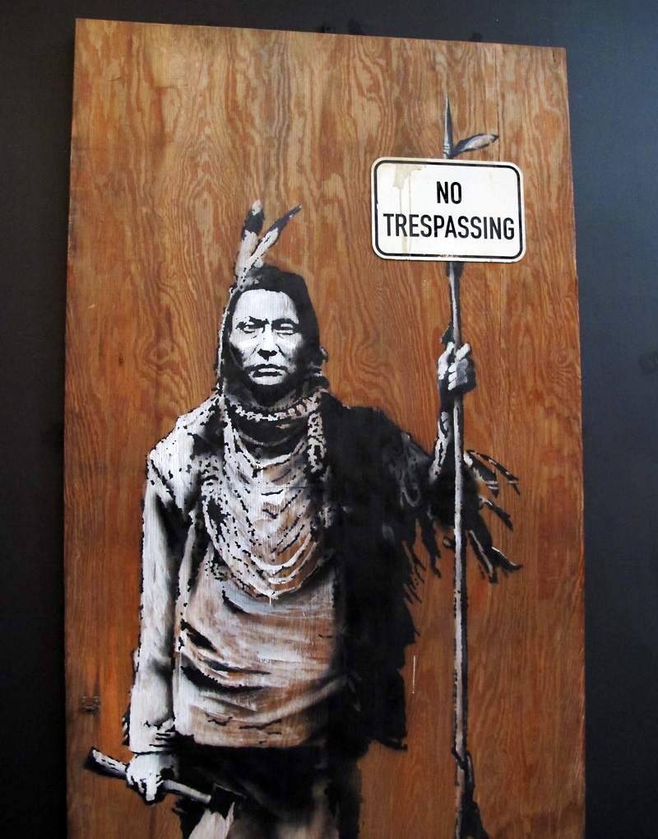

Slide 16
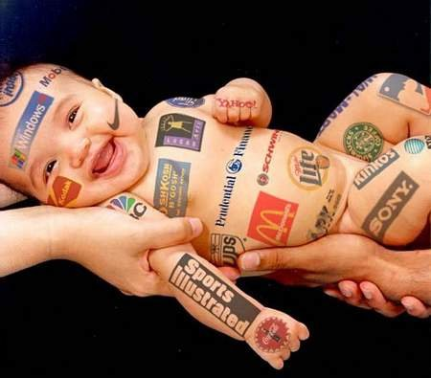

Slide 20
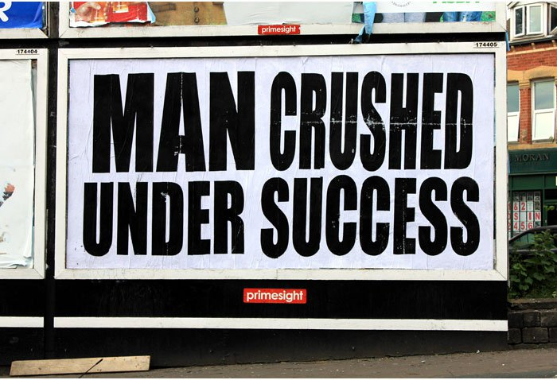

Slide 21
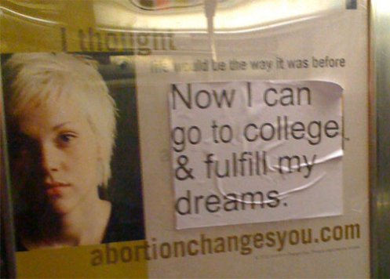

Slide 22
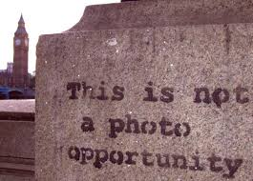

Slide 23
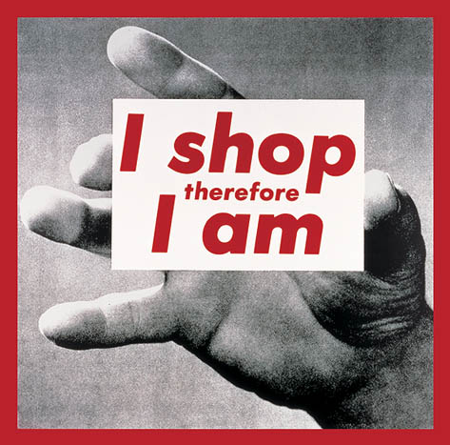

Slide 24
