Slide 1
Literary Analysis.
Critically Questioning the World of Literacies

Slide 2
English Major Creed.
No. One: It’s almost always a symbol.
No. Two: Overanalyze it until you are sick of looking at it.
No. Three: It is usually about power.
No. Four: Society is paradoxically the best friend & enemy.
No. Five: It’s okay to disagree. Sometimes, it is preferred.
No. Six: Be cynical.
No. Seven: Generalizing is dangerous. Watch your vocab.

Slide 3
Think Critically.
It’s about learning how to ask the right questions.
Secrets from the English Majors & Bloomington Hipsters:
Socio-Economic Status (SES)| It’s all about the money.
Power Hierarchies | Who’s got the power?
Race/Ethnicity | Race matters.
Language | It’s how you say it and in what language.
Gender | Patriarchy. Feminism.
Perspective | Who is the speaker? Hidden agendas?
Location | Where is this coming from?
Body Language/ Insinuations | What you’re saying without saying it.

Slide 4
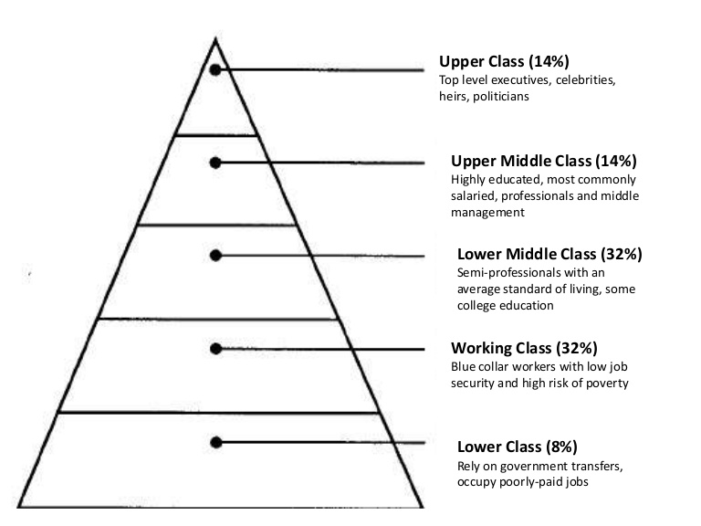
Socio-Economic Status
Socio-Economic Status (SES)| It’s all about the money.
Socio= Society (Social Class)
Economic= Monetary Stance (Social Class)

Slide 5
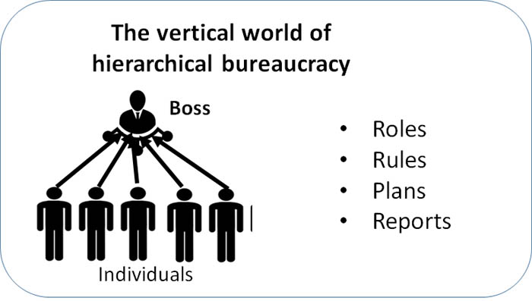
Power Hierarchies
Power Hierarchies | Who’s got the power?
Majority Rules
Money Talks
Adaptability Talks
Technology Talks
Bureaucracy (Top Down Models)
Hegemony

Slide 6
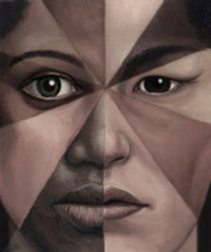
Race/Ethnicity
Race/Ethnicity | Race matters.
Race= biological affiliations based on perceived appearance
Example: American Indian, Hispanic, White/Caucasian, Black, Asian, etc.
Ethnicity= cultural lifestyle and group of practices
Example: French, Jewish, Korean, Nigerian, Navajo, Mexican, etc.

Slide 7
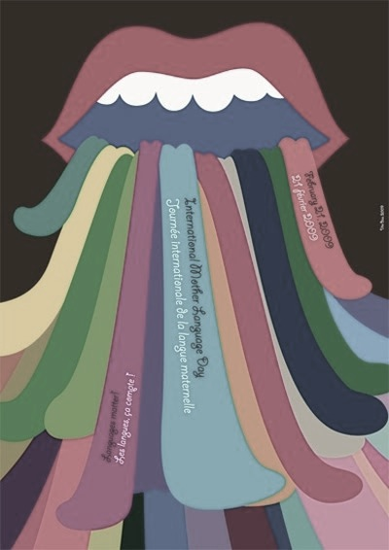
Language
Language | It’s how you say it and in what language.
Gendered Languages
Semantics that vary between languages
Language barriers
Connotations (social influences on language)
Language of powerful countries
Who is publishing?

Slide 8
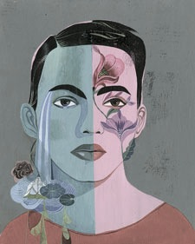
Gender/ LGBTQ
Gender | Patriarchy. Feminism.
Gender= personal identification and life style choice
Sex= biologically predisposed organs

Slide 9
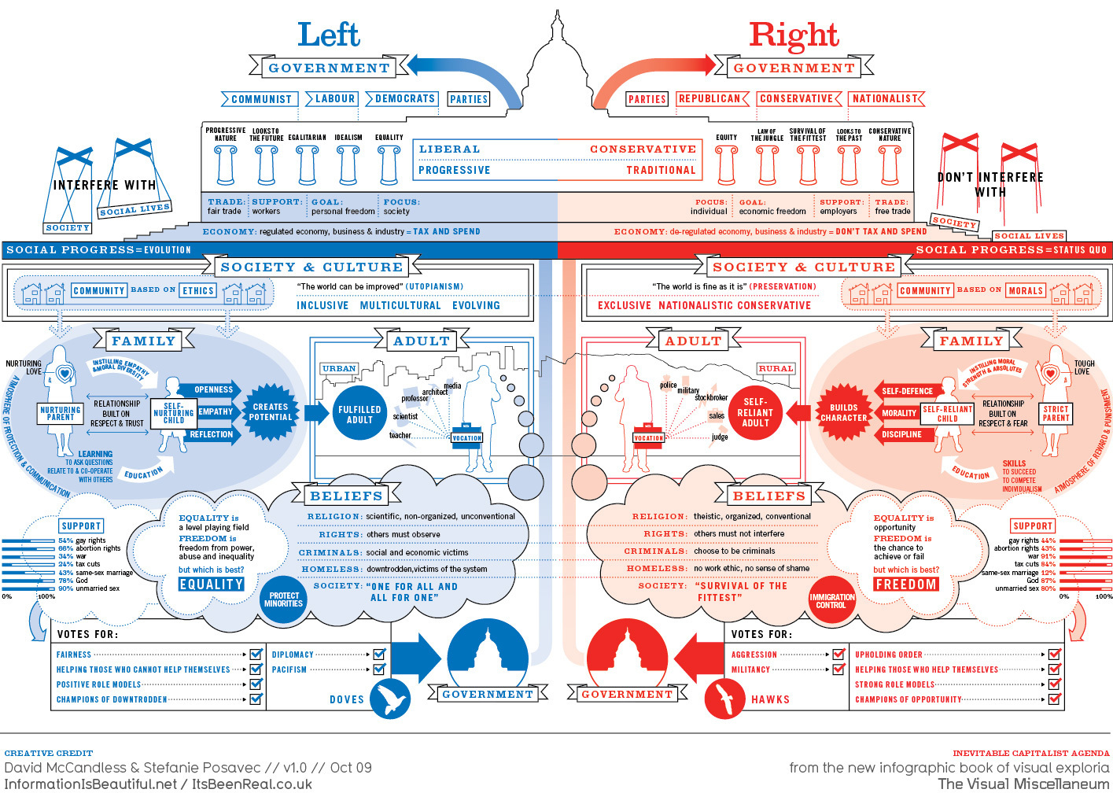
Perspective
Perspective | Who is the speaker? Hidden agendas?
Politics (political party affiliations and platform ideologies)
Religion (religious organizations and doctrines)
Other (critics, non-traditionalists, etc.)

Slide 10
Location & Culture
Location | Where is this coming from?
Where is this story located?
How does the location influence the cultural viewpoint of the writer?
Is the location a first world country, a third world, a poor area, a rich area, etc.?

Slide 11
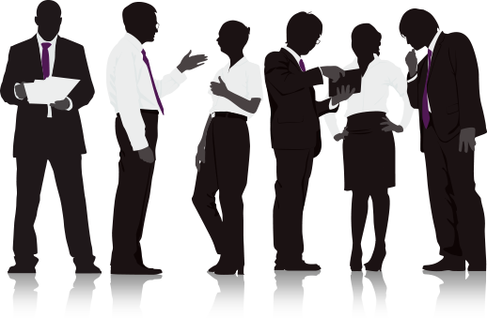
Body Language/Insinuations
Body Language/ Insinuations | What you’re saying without saying it.
The power of hints: rolling eyes, winks, sideways glances, smirks, thought bubbles, protective positions, aggressive stances, etc.
Proximity

Slide 12
Ideologies.
Society is dominated by ideas that influence practice.
The ideas that have been around longer create routine practices that are sometimes hard to notice, because they are so normal in everyday life.
The more normalized a practice- the more ideological.
Questions?

Slide 13
The Isms. (& Some Aren’t)
Many ideologies are given labels to help group together common strands of the major theme or main idea.
For example: Feminism, racism, materialism, collectivism, individualism, patriarchy, neoliberalism, Republicanism, Catholicism, Protestantism, Atheism, hipsterism, etc. …
Ideologies are like trees.

