Slide 1
Argumentative Writing
The Art of Rhetoric

Slide 2
Persuasive Versus Argumentative
Argumentative includes the counterargument.
Persuasive is just expressing an opinion to try to convince the audience of the presenter’s (speaker, writer, poet, etc.) ideas and thoughts.
Argumentative is another level. It is trying to convince the audience, but it also takes into consideration what the audience will think and has a comeback ready to go.

Slide 3
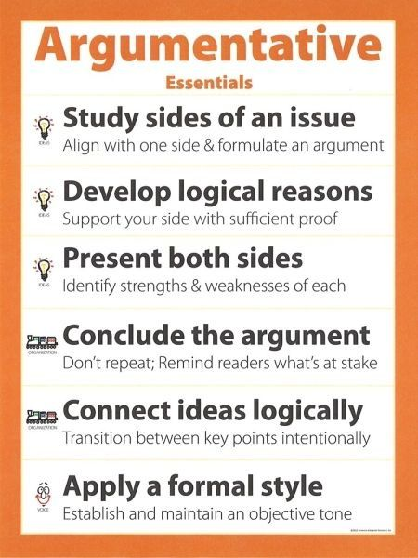
Some Side Notes…
Writing an argumentative paper shows me that you have full command on a given subject. It is a research paper on steroids.
When you write an argumentative paper, I am looking for your ideas and their relationship to the research that you have included.
Research can be used for many things. First, it can be used to show me that you are not alone in your thought process. Secondly, it could show me what scholars and other professionals in the field are saying and how your critical vantage point is different from the proposed research.

Slide 4
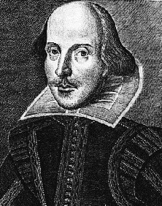
A1: Shakespeare Controversy
You will select a card with either a two (2) or a eight (8) on the card.
Two People: You are writing an argumentative piece that claims Shakespeare was the one and only writer of his tragedies, comedies, and histories.
Eight People: You are writing an argumentative piece that claims Shakespeare was just a pen name. Therefore, there are at least two (or more) writers of the Shakespearian pieces we study today.

Slide 5
Comprehensive Overview
At least a one-page paper, single-spaced, MLA format, with a minimum of four paragraphs total. The bibliography (Works Cited Page) will accompany the argumentative paper.
Introduction (with hook and complex thesis sentence employing both a dependent and independent clause).
Two Body Paragraphs: One will present your claim and assigned viewpoint. The other will present the counterargument.
Conclusion (with a recap and restatement of the thesis in a new way).

Slide 6
BP1: The Argument
Group Two People: Shakespeare One & Only
Group Eight People: Shakespeare Pen Name
Topic Sentence (one sentence)
Elaboration (one to three sentences)
Textual Support (QUOTE)
MLA In-Text CITATION
Explanation (three or more sentences)
Concluding Sentence (one sentence)

Slide 7
BP2: The Counterargument
Group Two People: Shakespeare Pen Name & Why That is WRONG
Group Eight People: Shakespeare One & Only & Why That is WRONG
Topic Sentence (one sentence)
Elaboration (one to three sentences)
Textual Support (QUOTE)
MLA In-Text CITATION
Explanation (three or more sentences)
Concluding Sentence (one sentence)

Slide 8
The Introduction
Please select at least one of the following:
1. Anecdote or analogy
2. Rhetorical Question
3. Fact or Statistic
ELABORATE A BIT
WRITE the Thesis Statement

Slide 9
The Conclusion
Integrate something of relevance. For example, the celebration of Shakespeare, hip-hop and Shakespeare, the influence of Shakespeare in Western education systems, the influence of Shakespeare in literary history, etc. THIS IS THE TAKEAWAY.
Restate your position. Retouch on the counterargument. Write a CALL TO ACTION of sorts… For example, if we continue to study Shakespeare in American classrooms, it is pivotal to acknowledge the controversy behind his name and the potential role of de Vere in the vast richness of Shakespearian literature.

Slide 10
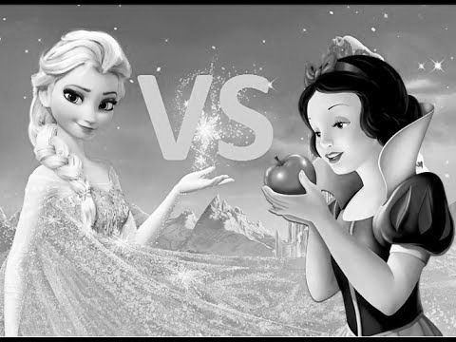
A2: Fairytale Rivals
Now, your turn. You need to select two Disney “fairytales” and make an argument as to which is the better of the two. You can be creative with this. For instance, maybe you want to compare Snow White to Elsa.
But here is the catch, because it is my class. You now there will always be a catch. You have to convince the reader why the fairytale you selected has a greater role in literature and society in contemporary society.
Follow the same format as the A1 Paper. However, this time, you will be using direct quotes from the movies (or the books if applicable). If you find other scholarly work on the fairytales, you can use that as well. JUST REMEMBER to CITE.

