Slide 1
Romeo & Juliet
By William Shakespeare

Slide 2
The Preface…

Slide 3
William Shakespeare

Slide 4
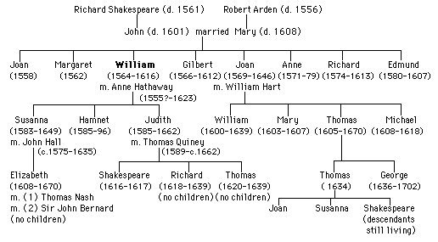
Shakespeare Family Tree

Slide 5
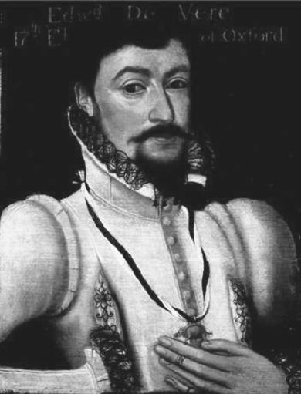
Edward de Vere
Some individuals and scholars of Shakespeare believe that the true author of these works was Edward de Vere.
However, since an actor and playwright was not an acceptable profession for a member of the aristocracy, de Vere could not use his own name.

Slide 6
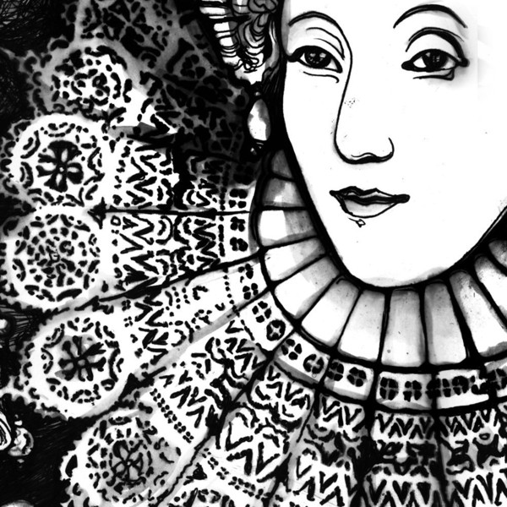
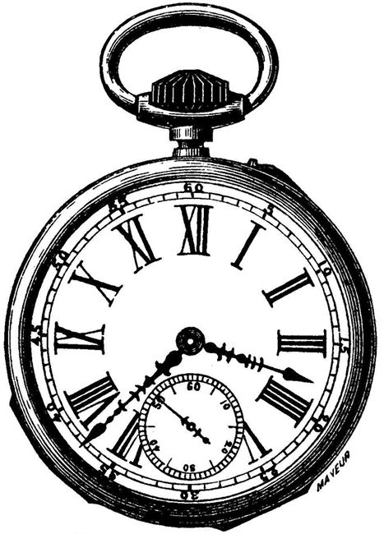
The Timeframe: Elizabethan England
1558-1603

Slide 7
The Plays
Shakespeare’s plays include comedies, histories—and tragedies such as Romeo and Juliet.
Some of his other famous plays include Julius Caesar, Hamlet, Macbeth, Othello, and A Midsummer Night’s Dream.
In addition, Shakespeare wrote love poems called sonnets.

Slide 8
TYPES OF PLAYS
Tragedies
Comedies
Histories

Slide 9
Theater
The theater in Shakespeare’s day was tremendously different from what we see today.
Being an actor was not a highly regarded profession; actors were looked down upon in society.

Slide 10
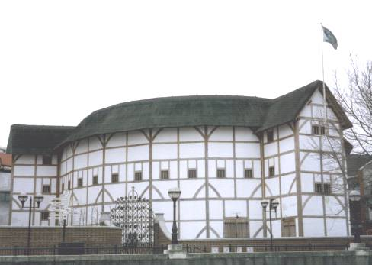
The Globe
Shakespeare’s plays were performed in a theater called the Globe, sometimes called“The Wooden ‘O’” because of its circular shape.

Slide 11
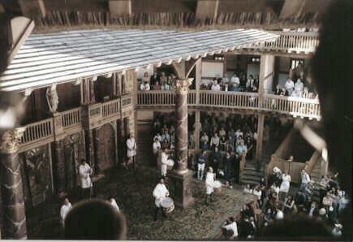
The reconstructed stage of the Globe
Theaters had no lighting, so performances took place during the day.
There were few special effects or props; Shakespeare used detailed verbal description to paint a picture of his scenes.

Slide 12
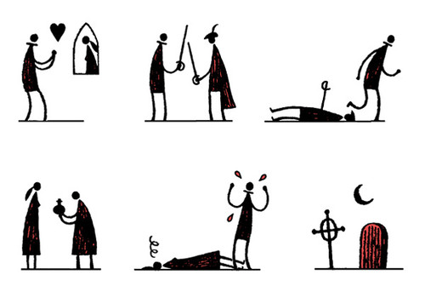
Actors and Actresses
In Shakespeare’s time, it was considered immoral for a woman to appear onstage.
So, the female roles in Shakespeare’s plays were performed by young men.

Slide 13
Context
The time period in which Shakespeare lived—Elizabethan England, named for the queen—influenced the content of his plays as well as the way in which they were performed.
Elizabethans believed the earth was flat…

Slide 14
The Four Humors
In Elizabethan times, people believed that a person’s mental, physical, and emotional state were determined by the balance of the four“humors” in the body: blood, yellow bile, phlegm and black bile. They believed the humors gave off vapors that affected the brain, so whatever humor dominated would determine your personality type.

Slide 15
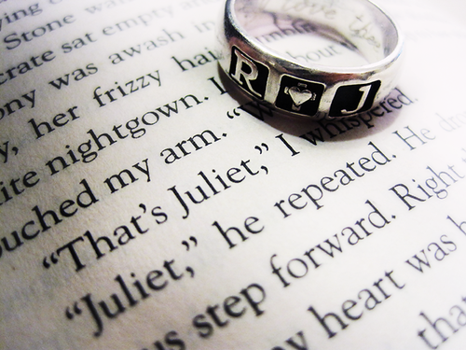
Marriage
In Shakespeare’s day, marriages were generally contracts set up by the parents.
When Juliet’s parents arrange a marriage for her, it seems strange to us; Shakespeare’s audience would have thought it was completely normal.

Slide 16
Tragedy
Shakespeare’s tragedies also follow a pattern that would have made sense to his audience.
Elizabethans believed that people’s decisions and mistakes always had consequences, and that people sometimes had to pay a high price for their mistakes.
In Shakespeare’s tragedies, the main characters make decisions that upset the proper order of their world and so affect them and everyone around them. The situation is resolved only when others learn lessons from the main characters’ deaths.

Slide 17
Why we read…
So why do we still read plays like Romeo and Juliet? When Shakespeare’s world was so different from ours, what can we learn from his plays?
Well, the plays are not only great, powerful stories—they also teach lessons about life that apply to people in all cultures and time periods, and those lessons can help us when we come across hard times in our own lives.
Because… in the classic guise we can talk about drugs, sex, violence, lust, love, teenage angst, death, melodrama, and you know, the meaning of life and such…

Slide 18
Keep in Mind:
Don’t be alarmed by the old-fashioned language: this is really a play about people who are a lot like us, and the difficult words, when you look at them carefully, express emotions anyone can understand.
And remember, the play is POETRY: it’s not supposed to be written exactly the way people talk. The poetry is part of what makes it beautiful and powerful—and worth reading.

Slide 19
Reading the Play
Two things to know:
Sometimes a character will give a long speech all by herself, revealing her secret thoughts to the audience: this is called a soliloquy.
Sometimes a character will just make a brief comment to the audience that the other characters don’t hear; this is called an aside.
Shakespeare’s plays were meant to be performed—they were some of the most popular entertainment of their time. So when we read the play, the point is to try and imagine it happening onstage.
Because of the minimal props and scenery, the action in Shakespeare’s plays had to be conveyed through words and conversations. A conversation between characters is called DIALOGUE.

Slide 20
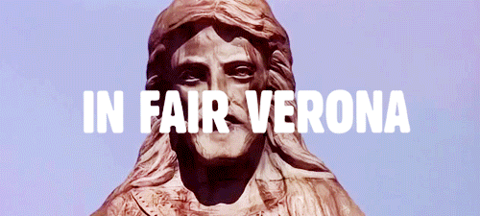
The Setting

Slide 21
So Who Is Who Here?
First of all, all of the characters in Romeo and Juliet are arranged around a central conflict between two rival families:
The Montagues
The Capulets.

Slide 22
The Montagues
Romeo
Montague
Juliet’s
father
Lady
Montague
Juliet’s
Mother
Mercutio
Juliet’s
cousin
Benvolio
Juliet’s
nanny

Slide 23
The Capulets
juliet
Capulet
Juliet’s
father
Lady
Capulet
Juliet’s
Mother
Tybalt
Juliet’s
cousin
Nurse
Juliet’s
nanny

Slide 24
The Peacemakers:
The Prince of Verona:
This ruler tries to mediate between the feuding families.
He is pretty tired of all the bloodshed caused by their “ancient grudge.”
Friar Lawrence:
This religious leader is respected as a holy man by both sides, and would like to see them reconciled.
As a friar, he’s interested not only in religion, but also in medicinal herbs—which becomes important later.

Slide 25
And finally…
One other “character” :
The Chorus
The Chorus is not a part of the action, but a speaker who comes onstage to make comments on the action. The Chorus is kind of like a TV announcer in contemporary life—as far as the characters know, the chorus does not exist, but he helps explain things to us.

Slide 26
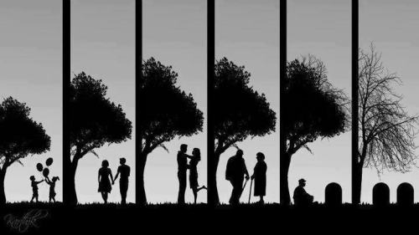
Perspective Write: The True Love Story
Do you personally think that the true love story is only a few fleeting chapters in the life story or do you think it is a longer process? How do you think media and generational views influence your opinion?

Slide 27
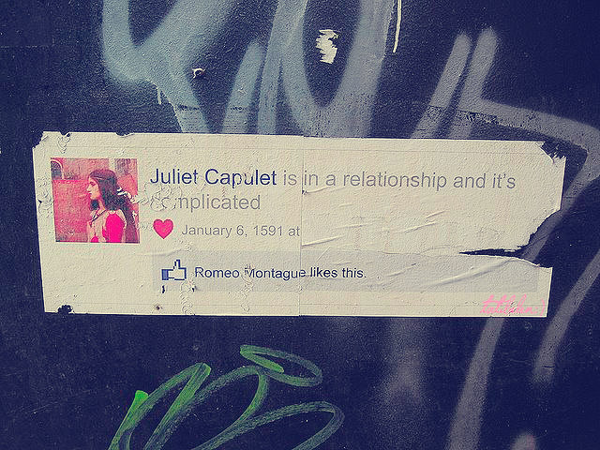
Perspective Write: Technology
Technology has changed our society and in many ways the love complications of many. How do you think this play would be different if it were set in contemporary times?

Slide 28
Perspective Write: Flawed Interpretations
Do you think this play could be misinterpreted? In what ways do you think an individual could misread this play in contemporary society?

Slide 29
Perspective Write: Ambiguity
Think of words that have double meanings. Try to come up with a minimum of three. These words are called HOMOGRAPHS. How does the homograph “lie” change the above situation? Create your own situation in writing in which a homograph changes the understanding.

Slide 30
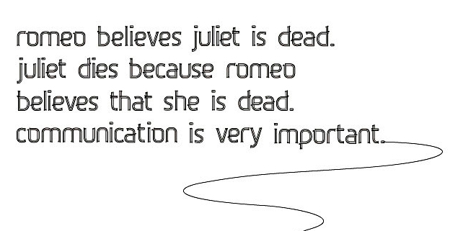
Perspective Writing: References
How has Romeo and Juliet been used in various forms of media? Think of an example. Do you think in 100 years, people will still be using Romeo & Juliet references?

