Slide 1
Night by Elie Wiesel
Background Knowledge

Slide 2
When Numbers are People.
1.5 Million
6 Million
3 Million
2 Million
400,000
30 Million
1.7 Million
100,000
800,000
300,000
Over 50 Million Systematically Killed
Our World= 7.3 Billion (Less than 1% of the population- 0.6%)

Slide 3
“Genocide Unearthed”
More than 50 million people were systematically murdered in the past 100 years—the century of mass murder: From 1915 to 1923 Ottoman Turks slaughtered up to 1.5 million Armenians. In mid-century the Nazis liquidated six million Jews, three million Soviet POWs, two million Poles, and 400,000 other "undesirables." Mao Zedong killed 30 million Chinese, and the Soviet government murdered 20 million of its own people. In the 1970s the communist Khmer Rouge killed 1.7 million of their fellow Cambodians. In the 1980s and early '90s Saddam Hussein's Baath Party killed 100,000 Kurds. Rwanda's Hutu-led military wiped out 800,000 members of the Tutsi minority in the 1990s. Now there is genocide in Sudan's Darfur region. (Simons, 2006, 1).
http://ngm.nationalgeographic.com/2006/01/genocide-unearthed/simons-text/1

Slide 4
Darfur Genocide
In February of 2003 the Sudan Liberation Movement and Justice & Equality Movement groups began fighting.
Current today is the mass slaughtering, rape, and displacement of Darfuri men, women, and children.
Death Toll: 300,000 People

Slide 5
Rwandan Genocide
In 1994, the Tutsi people were mass murdered in Rwanda by members of the Hutu majority.
Death Toll: 800,000 in the space of 100 days
http://www.bbc.com/news/world-africa-13431486

Slide 6
Armenian Holocaust
The Ottoman government organized systematic killings of Armenians in 1915 through deportation and mass murder.
Forced labor for men and death marches for women and children through the Syrian desert.
Death Toll: 1.5 Million People

Slide 7
Borrowed From SlideShare

Slide 8
Borrowed From SlideShare

Slide 9
Borrowed From SlideShare

Slide 10
Borrowed From SlideShare

Slide 11
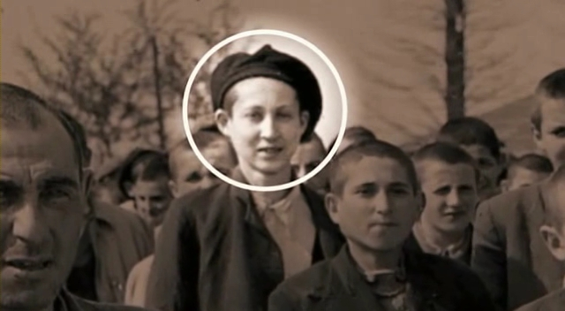
Elie Wiesel

Slide 12
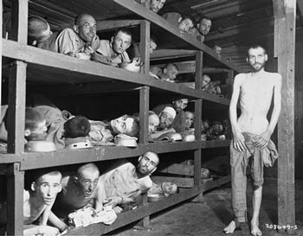

Slide 13
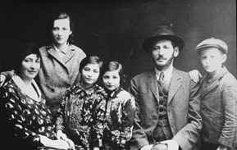
The Wiesel Family

Slide 14
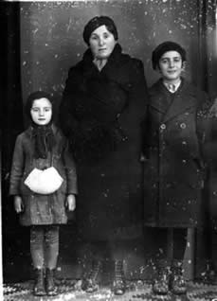
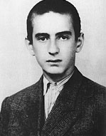

Slide 15
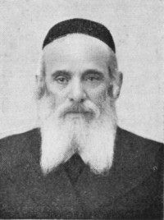
Moshe the Beadle

Slide 16
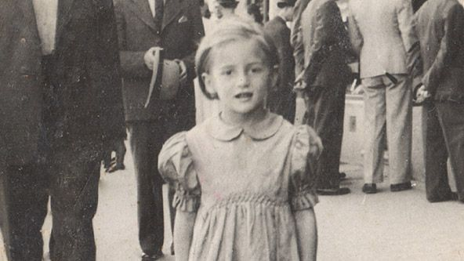
Tzipora Wiesel

Slide 17
Interview with Elie Wiesel
http://www.schooltube.com/video/7d5afe2a261101d87e45/

