Slide 1
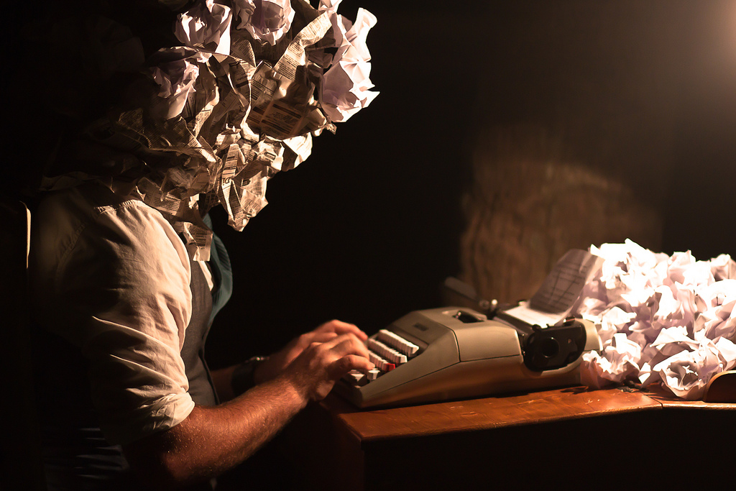
Narrative Writing
Expectations with a Pinch of Advice

Slide 2
Assignment Expectations
We are writing a PERSONAL NARRATIVE… not a memoir. Know the difference. Write about one focusing event or memory.
Length: 2 to 5 pages
(Word Count: 500 to 1250 words)
Font: 12-pt. Times New Roman
Margins: 1-inch
Double Spaced

Slide 3
MLA Heading
You do NOT need a cover page.
However, you NEED (in the upper left hand corner):
Your Name
Ms. Fougerousse
English 10H Narrative
23 September 2016

Slide 4
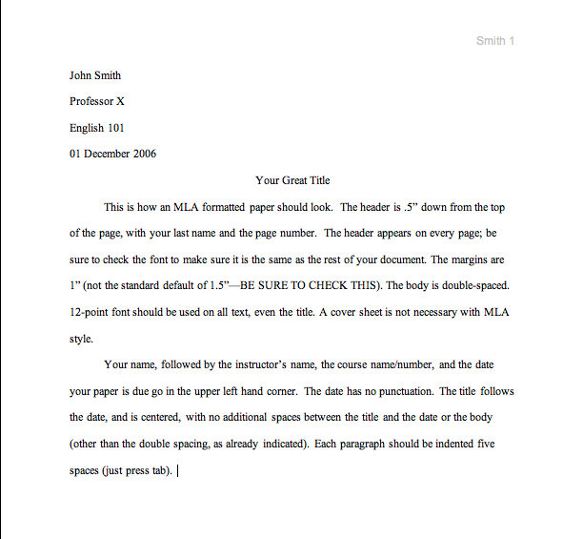
MLA Heading
In the header, you need your last name and the page number.
Your title should be in Times New Roman, 12-pt. font

Slide 5
Expectations
Introduction includes a hook, utilized to grab the audience’s attention (anecdote/analogy/rhetorical question/statistic/proven fact).
Introduction includes a thesis statement with a bigger idea or theme that makes the personal experience versatile and universally relatable.

Slide 6
Hook Options
Anecdote or Analogy (a.k.a. short story or a comparison that perpetuates the theme of your personal narrative)
Statistic or proven fact
Rhetorical Question (question that doesn’t need to be answered, but is utilized to get you thinking about the theme inherent in the personal narrative)

Slide 7
Expectations
Body paragraphs display the five elements of the plot diagram. The narrative has a clear exposition (beginning), rising action, climax, falling action, and resolution (end).
The conclusion is reflective. It restates the thesis in a new way. It ties together the experience or memory.

Slide 8
Thesis Starters
This story exemplifies…
It was this moment that taught me…
Due to this, …
My Thesis: This is a story that reveals regret and, in simple ink on paper, strives to compensate for wasted time and immaturity that lies in the stones, constellations, and weather patterns of my life.
OR… This is for the regret that taught me to pay attention to those people who catch you in moments of immaturity; for they will write in the stones, remain in the constellations, and revisit in the weather patterns of life.

Slide 9
I Need to Write More…
Consider the following:
Character Development (personality, appearance, etc.)
Include more detail (integrate sensory details). Elaborate on the setting.
Add dialogue to enhance the story.
Elaborate anywhere that you can ask the question “why?”
Find a quote that you can reference throughout the story and create a cohesive feeling in your writing.

Slide 10
Grades…
A-ish Paper: Goes above and beyond set expectations. Is the epitome of exemplary work. Please become an author.
B-ish Paper: Above average. Exceeds minimum expectations. Good work!
C-ish Paper: Meets minimum expectations.
Dish Paper: Does not meet expectations or minimum requirements.
F Paper: …

Slide 11
Les Questions?
At the end, you should have:
Pre-Writing Activity (graphic organizer, starter paragraph, or drawing w/ explanation).
Final Draft: Your beautiful personal narrative.

