Slide 1
A Midsummer Night’s Dream
…

Slide 2
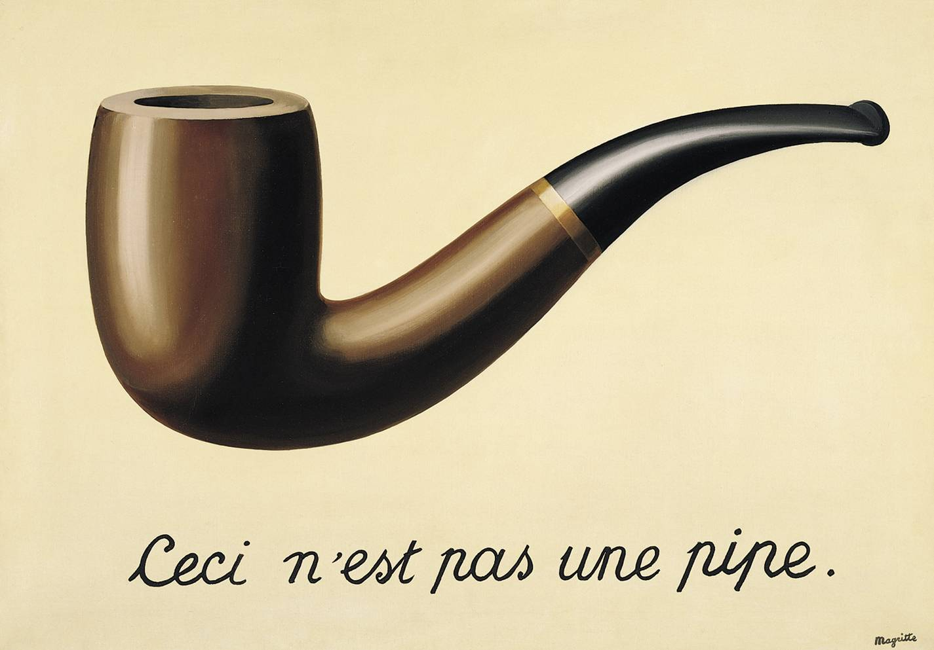
Ceci n’est pas une pipe.

Slide 3
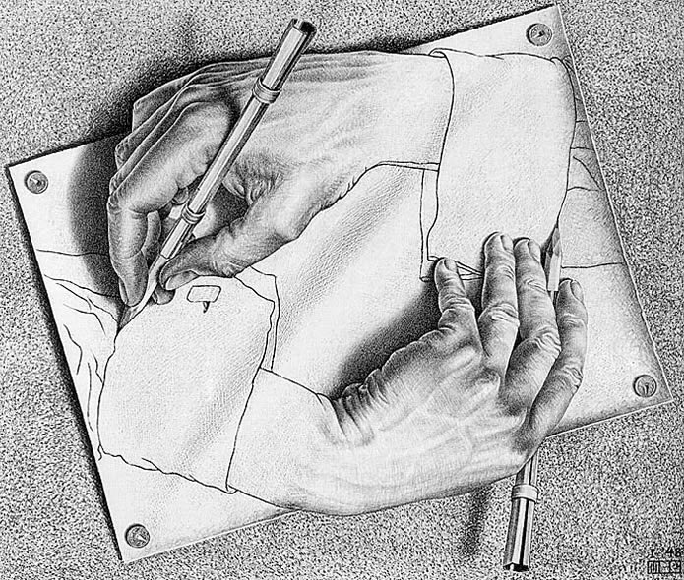
Mimesis
Mimesis is the imitation or a representation of the real world in art or literature.
Mimesis can be more broadly defined as re-creating something with a twist. With mimesis, there is something lost when going from one thing to another. Yet, with that loss, there is also a gain of some sort- a new creation.

Slide 4
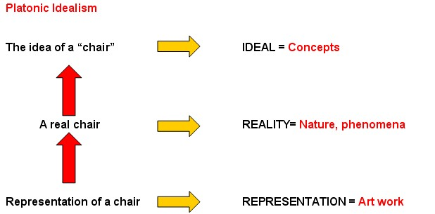
Understanding the Implications

Slide 5
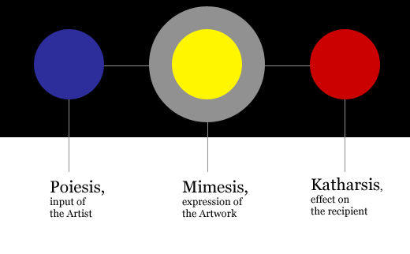
In Context…

Slide 6
Plato’s Theory of Mimesis
All Art is mimetic by nature
Art is an imitation of life
The idea is the ultimate reality
Art imitates the idea- an imitation of reality
Poetry is twice removed from reality

Slide 7
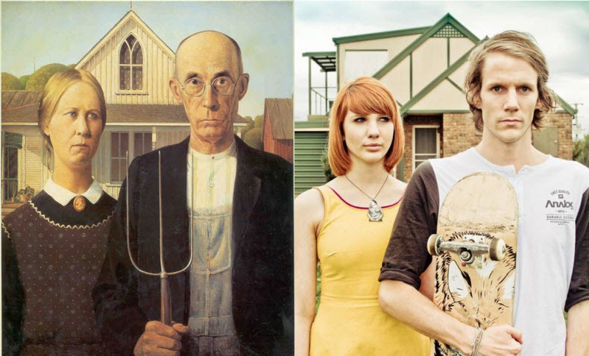
Example in Photography

Slide 8
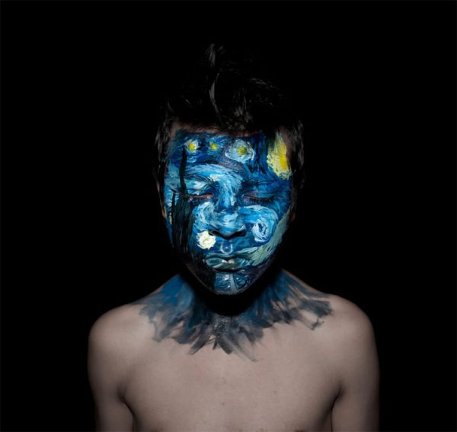
Example with Starry Starry Night

Slide 9
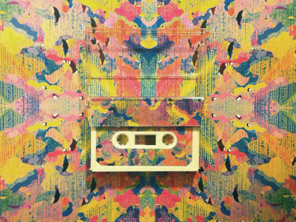
Example with Objects

Slide 10
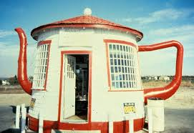
Example in Architecture

Slide 11
Mimesis in Literature
While it is easier to detect mimesis in visual art forms, it is also inherent in text. If it were not for mimesis, we would not feel connected to a text. We would not feel like we knew the characters as actual people. We would not be able to close our eyes and actually see the town in which the story takes place. Those instances of imagery and technique that make literature come alive are due to the art of mimesis.

Slide 12
Mimesis into Archetypes
Through the practice of mimesis, we see trends or prototypes that are replicated time and time again.
We call these artistic tropes archetypes.
Archetypes can be themes, colors, symbols, people, character types, settings, etc. The key qualifying aspect is their redundancy in literature and other forms of art.
So, in a sense, mimesis can create traditions or archetypes in our literary DNA as readers.

Slide 13
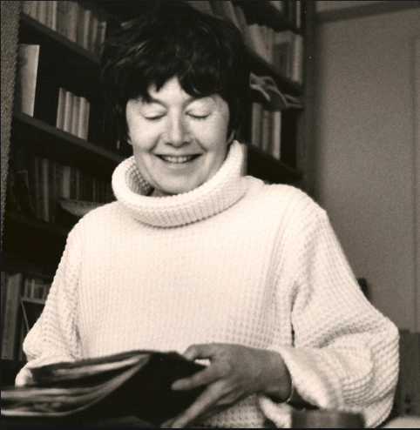
Radical Mimesis
Okay, though you are only sophomores, I am going to throw a little literary theory at you.
Luce Irigaray was a feminist critic. She wrote about patriarchy and all of the other concepts that we discussed when we read “The Yellow Wallpaper.”
There is one quote that sticks with me. She writes, “[One must] jam the theoretical machinery itself, [or] suspends its pretension to the production of a truth and of a meaning that are excessively univocal” (796).
Notes:
Irigaray, Luce. “The Power of Discourse and the Subordination of the Feminine.” Literary Theory, an Anthology. Ed. Julie Rivkin and Michael Ryan. 2nd ed. Malden, MA: Blackwell, 1998. 796-797.

Slide 14
Translation
Layman’s Terms: To make a stand or to make a point, you have to work with the system that you are stuck in. You have to learn the game so that you can find the loop holes and play it better than the rest.
Short Version:
Play the System

Slide 15
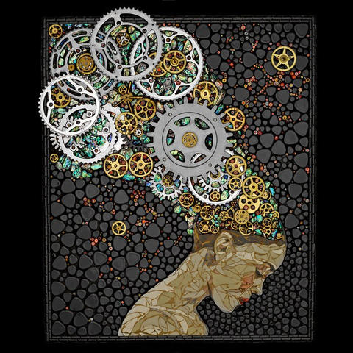
BIG Influences from Small Pasts
Elvis Presley
John Lennon
Mos Def
Marilyn Monroe
William Shakespeare
Diana Ross
Who else?

Slide 16
So where does Shakespeare come into play?
Shakespeare was like an DJ. He took other people’s work and tried to create something of his own. He is a little like Elvis. Elvis sprung from music associated with Black culture and created something that the mainstream culture loved. Love him or hate him for it, that is what he did. Shakespeare did the same thing.

Slide 17
How do you critique society when your position in society is so insignificant?
You hit the mainstream. If you want to reach millions, then you play the game in a place where more people will respond… Pop culture… mainstream culture…
The Catch: You have got to do it in a way that uses the old, but puts a new twist on it.
In the Middle Ages, they called that NEWFANGELEDNESS.
Shakespeare’s Mainstream: Theatre, Vernacular

Slide 18
Vernacular
Vernacular is another term for everyday language of a given time frame.
Examples of Internet vernacular that have derived since 1991 when Internet became available to present day:
“Turn Up” “TBT” “I can’t even.” “Hashtag” “YOLO” “Tweet” “Google it.” “Fam” “Slayin’” “K” “OMG” “Download” “FYI” “BTW” “ASAP” and so many others… Like people who excessively use LOL or lols in text messages…
Shakespeare used Elizabethan vernacular.

Slide 19
Tie to A Midsummer Night’s Dream
Take a fairytale and use the archetypes to create a traditional vibe.
BUT… then throw in some jabs. Shakespeare is the King of Backhanded Compliments. He is a word poet and he is passive in his approach, but that makes you feel smart when you figure it out.
With A Midsummer Night’s Dream, he played the system.

Slide 20
Name that Reference.
Bob Dylan “Oxford Town”- 1962 James Meredith enrolled in the University of Mississippi (in Oxford, Mississippi)
Don McLean “American Pie” (The Day the Music Died)- references The Beatles, Bob Dylan, Elvis, Janis Joplin, The Byrds, Richie Valens, Buddy Holly, & the Big Bopper
Dire Straits “Sultans of Swing”- references Romeo & Juliet
Lynrd Skynrd “Sweet Home Alabama”- criticizes Neil Young
Macklemore “Growing Up” references reading Langston Hughes, A Raisin in the Sun, The Alchemist, and James Baldwin, and listening to David Bowie, 2Pac, & Sam Cooke
Theseus & Hippolyta?
The Tale of Pyramus & Thisbe?

Slide 21
Like The Inside Joke
Huon of Bourdeaux (Medieval French romance) borrowed Oberon
Golden Ass by Apuleius
→ Tale of a man who turned into an ass
Metamorphoses by Ovid
The Tale of Pyramus and Thisbe
The Name Titania
Lives of the Noble Grecians and Romans by Plutarch
Borrowed Characters: Theseus & Hippolyta

