Slide 1
Literary Devices Terms 21-40
English Language Arts

Slide 2
Epitaph
an inscription on a tombstone or monument in memory of the person buried there
Example: “Remember friends as you go by / As you are now, so once was I / As I am now, you you shall be / Prepare for death and follow me”

Slide 3
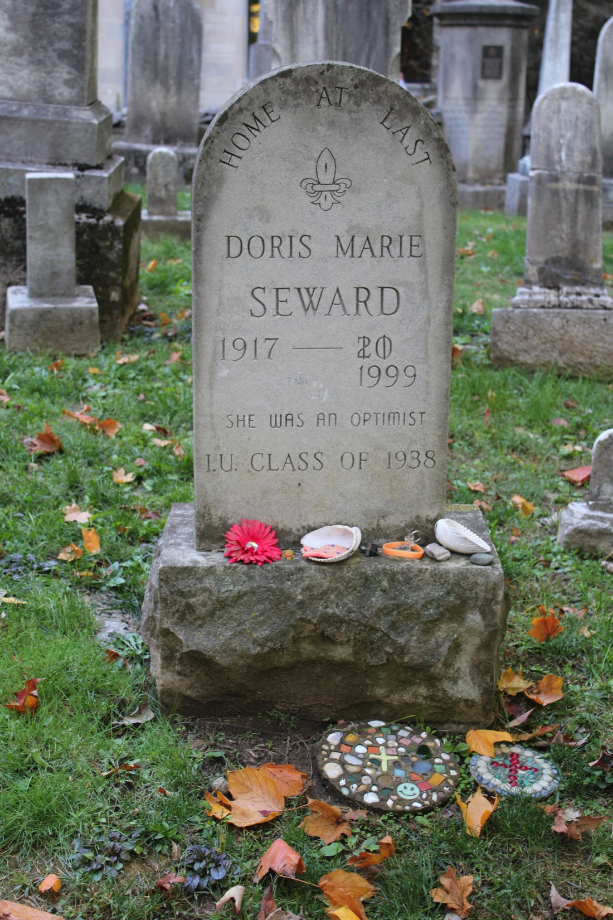
Epitaph

Slide 4
Euphemism
an indirect, less offensive way of saying something that is considered unpleasant
Example: Instead of saying, “He’s dead,” one might say, “He passed” or “He is in a better place.”

Slide 5
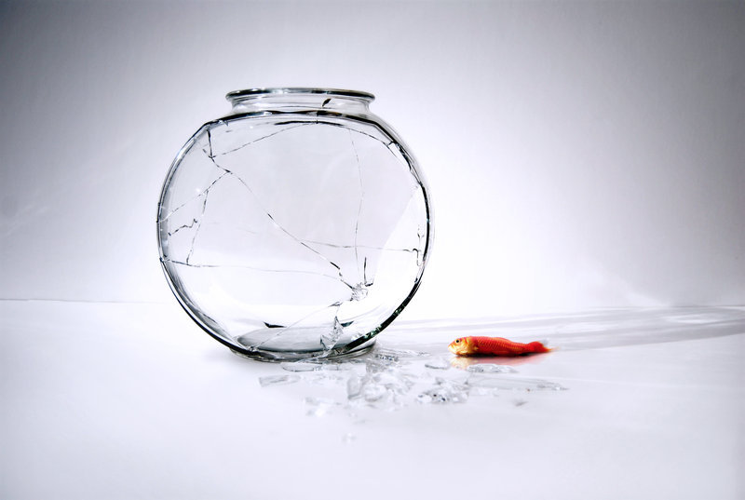
Euphemism

Slide 6
Euphony
pleasant words that are easy to articulate
Example: 'Tis hard to say, if greater Want of Skill / Appear in Writing or in Judging ill, /But, of the two, less dang'rous is th' Offence, / To tire our Patience, than mis-lead our Sense: /Some few in that, but Numbers err in this, / Ten Censure wrong for one who Writes amiss; / A Fool might once himself alone expose, / Now One in Verse makes many more in Prose.

Slide 7
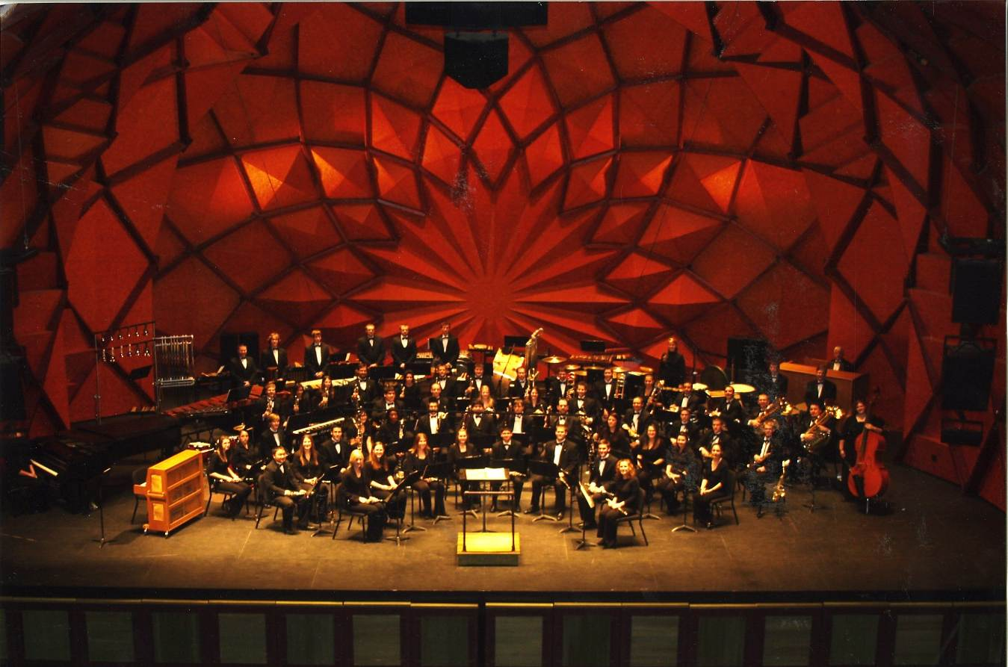
Euphony

Slide 8
Foil Characters
two characters that highlight each other by their differences
Example: Rowdy & Junior from The Absolutely True Diary of a Part-Time Indian by Sherman Alexie.
Example: Kevin & Tom Weylin from Kindred by Octavia Butler

Slide 9
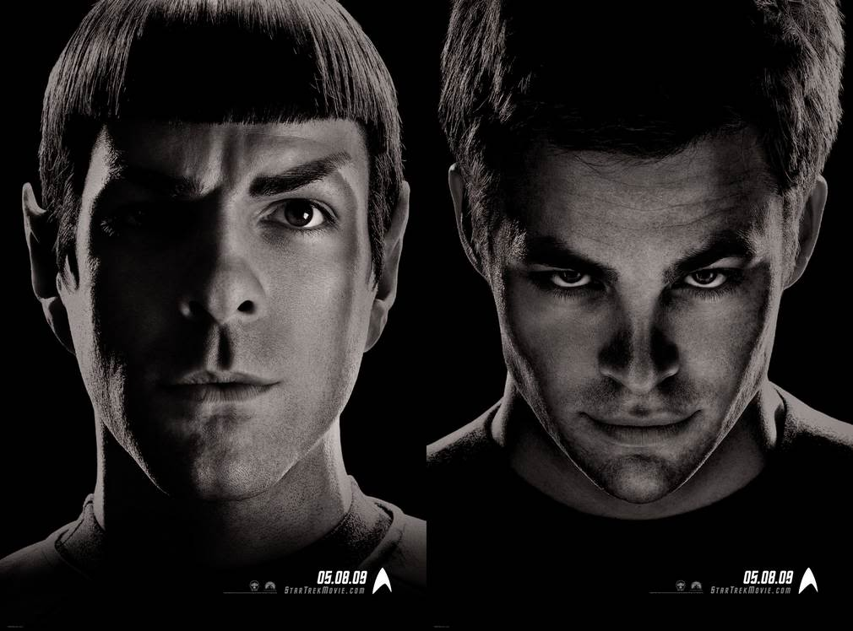
Foil Characters

Slide 10
Foreshadowing
the use of hints and clues to suggest what will happen later in a plot
Example: When Odysseus goes to see Tiresias, his fate is foreshadowed.
Example: In Kindred, Tom Weylin’s treatment of Sarah represents Rufus Weylin’s treatment of Alice. In so, Tom Weylin’s treatment of Luke foreshadows Rufus Weylin’s treatment of Sam.

Slide 11
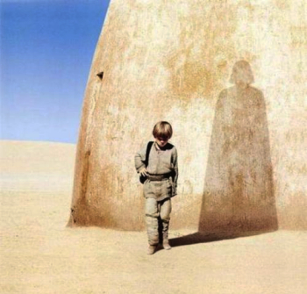
Foreshadowing

Slide 12
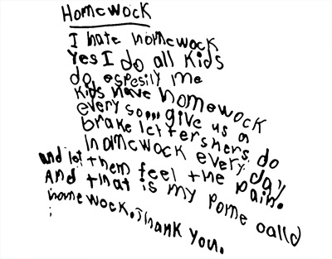
Free Verse
poetic form that does not have a regular meter or rhyme scheme
Example:

Slide 13
Hyperbole
a figure of speech that uses exaggeration to express strong emotion, make a point, or evoke humor
Example: There were a million people there! (When the venue only fits 150 people).

Slide 14
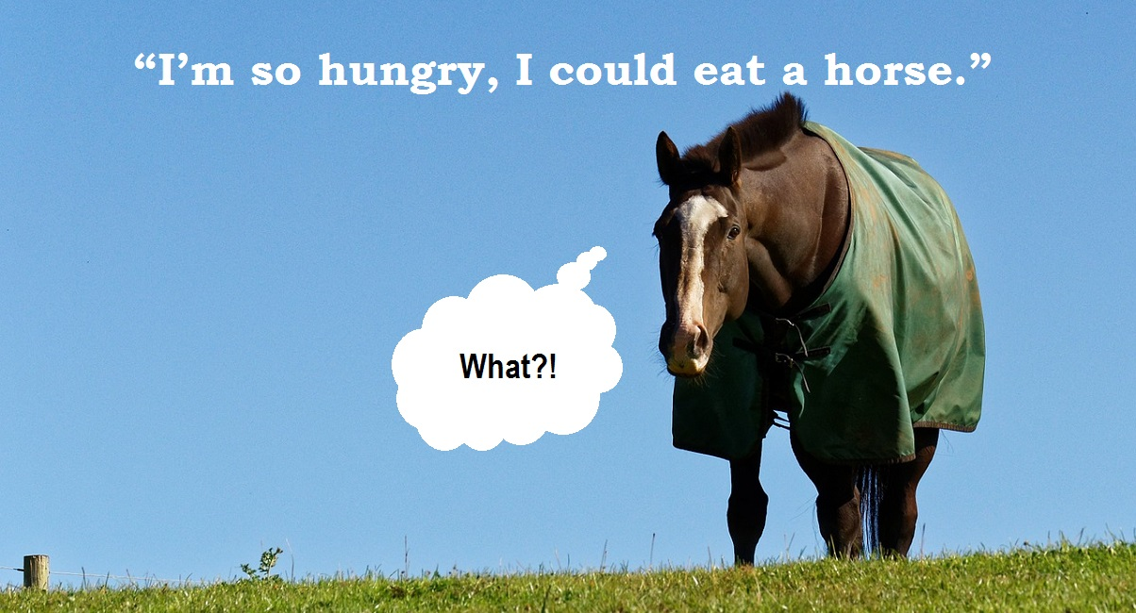
Hyperbole

Slide 15
Idiom
an accepted phrase or expression having a meaning different from the literal
Example: Get off your high horse. I’m on cloud nine. It’s raining cats and dogs. Who let the cat out of the bag? Cat got your tongue? Don’t jump the gun. We all have to pay the piper. Quit singing the blues. You’re playing the world’s smallest violin. I’m sick as a dog. You’ve got a chip on you shoulder. It takes two to Tango.

Slide 16
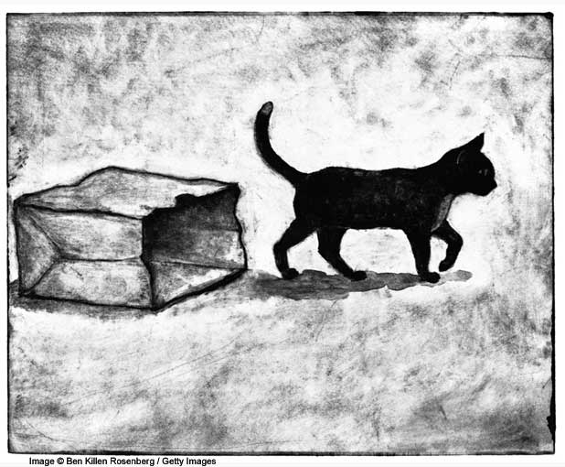
Idiom

Slide 17
Imagery
when the writer or speaker uses their descriptions to access the senses of the reader or listener
Example: When Junior says that he looks like a capital L walking down the road, he is using imagery.
Example: Whenever Dana describes the Weylin house, she is using imagery.

Slide 18
Imagery

Slide 19
Internal Rhyme
rhyme that occurs within a line, rather than at the end
Example: “Once upon a midnight dreary, while I pondered weak and weary.” from “The Raven” by Edgar Allan Poe

Slide 20
Internal Rhyme

Slide 21
Irony
a contrast between what is expected and what actually exists or happens
Example: There is irony when the audience knows what is happening in Romeo & Juliet, but the characters do not.
Example: In “Sweat” by Zora Neale Hurston, it is ironic that the title is two-fold. It both represents Delia’s hard work and Sykes sweat at the end.

Slide 22
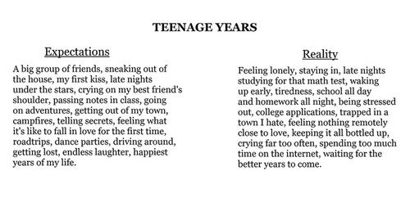
Irony

Slide 23
Juxtaposition
placing two elements side by side to present a comparison or contrast
Example: By comparing Rowdy to Gordy, one can understand the differences in friendships in Sherman Alexie’s The Absolutely True Diary of a Part-Time Indian.
Example: By juxtaposing Demetrius and Lysander, one can analyze the concept of “love,” in Shakespeare’s A Mid-Summer Night’s Dream.

Slide 24
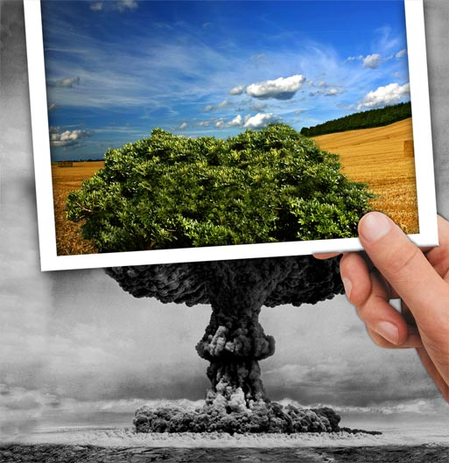
Juxtaposition

Slide 25
Lyric
a short poem of songlike quality
Example: Cheers Theme: “Making your way through the world today / Takes everything you got. / Taking a break from all your worries, / Would really help a lot. / Wouldn’t you like to get away? / Sometimes you want to go / Where everybody knows your name, / And they are always glad you came…”

Slide 26
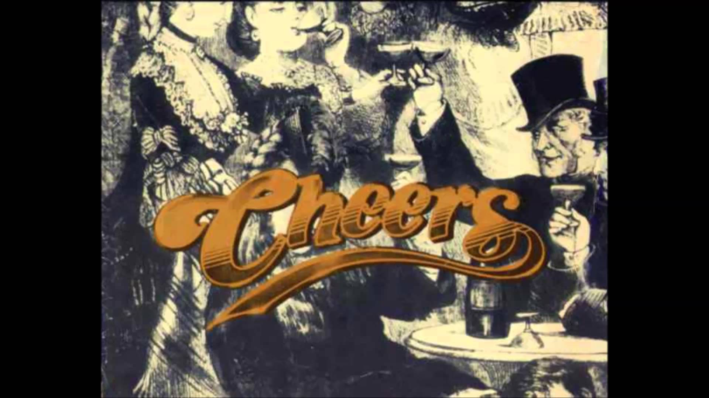
Lyric

Slide 27
Metaphor
a comparison between two unlike things
Example: If Forrest Gump had said: “Life is a box full of chocolates… You never know what you’re gonna get.” INSTEAD of “Life is like a box of chocolates…” It would be a metaphor.
Life is a rollercoaster…

Slide 28
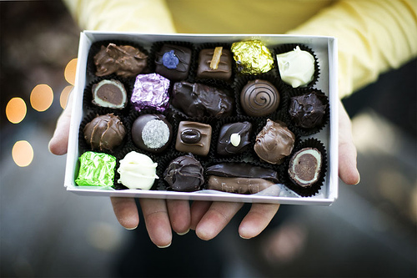
Metaphor

Slide 29
Meter
a pattern of stressed/unstressed syllables in poetry
Example: Shakespeare’s “Sonnet 18”

Slide 30
Meter

Slide 31
Monologue
a speech made by one actor or speaker
Example: VERY COLLEGE LECTURE
Example: When Oberon speaks about love-in-idleness, in Shakespeare’s A Mid-Summer Night’s Dream, he is giving a monologue.

Slide 32
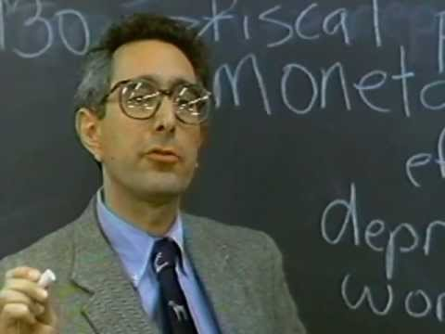
Monologue

Slide 33
Ode
a poem usually addressed to a particular person, object or event that has stimulated deep and noble feelings in the poet
Example: “Ode to a Grecian Urn” by John Keats.

Slide 34
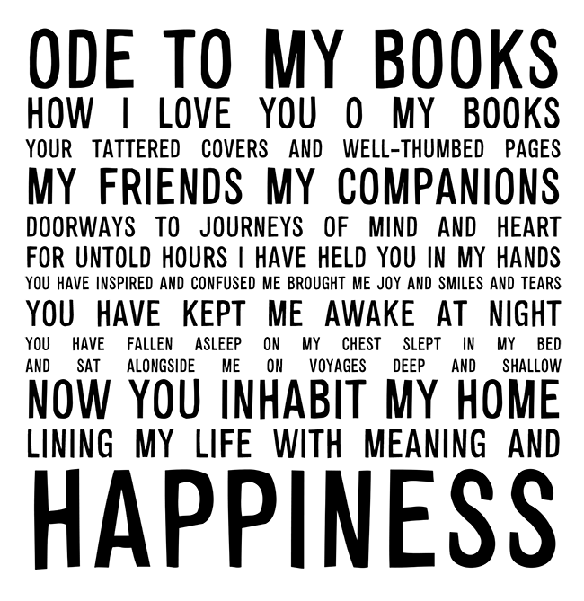
Ode

Slide 35
Onomatopoeia
when the words sound like what they mean
Example: The clock goes tick-tock. The rain goes drip-drop. The bomb went boom.

Slide 36
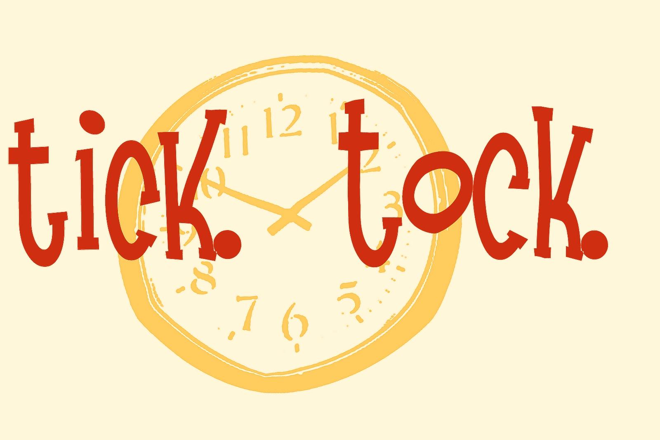
Onomatopoeia

Slide 37
Oxymoron
an expression in which two words that contradict each other are joined
Example: Pretty Ugly. Love-hate relationship. Icy Hot. Less is more. Bitter Sweet. Jumbo Shrimp. Only choice. Freezer Burn.

Slide 38
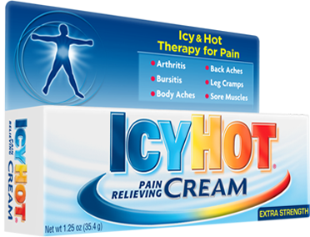
Oxymoron

Slide 39
Paradox
an apparently contradictory statement that actually contains some truth
Example: I am nobody. War is peace.
Example: Orwell’s 1984: “Ignorance is bliss.”
Example: In Shakespeare’s Hamlet, he claims, “I must be cruel to be kind.”
Example: The Beatles “I Am the Walrus” states, “I am he as you are he as you are me and we are all together.”

Slide 40
Paradox

