Slide 1
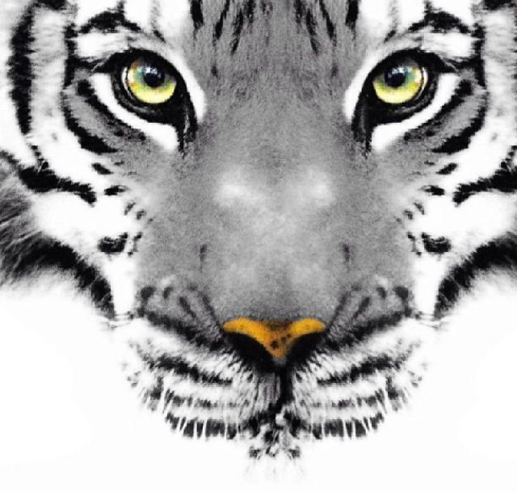
Life of Pi
Back Stage

Slide 2
Power

Slide 3
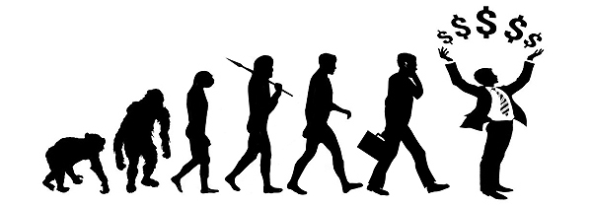
Mediums for Power
Physical Appearance
Biological Predispositions
Money
Media
Inheritance/tradition
Social Positions of Authority
Etc.

Slide 4
Traces from British Literature
The Natural Elements
The Distinction of Social Ranking
Great Chain of Being Philosophy
The Concept of the Tripartite Soul (Plato)

Slide 5
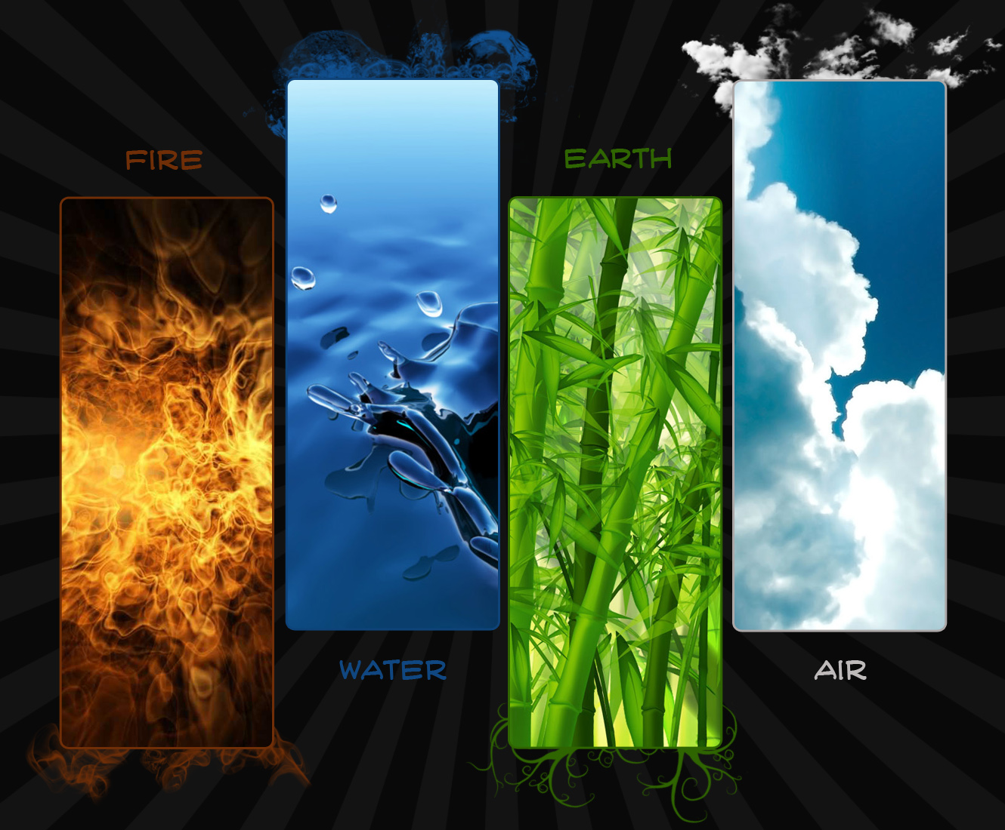
The Natural Elements

Slide 6
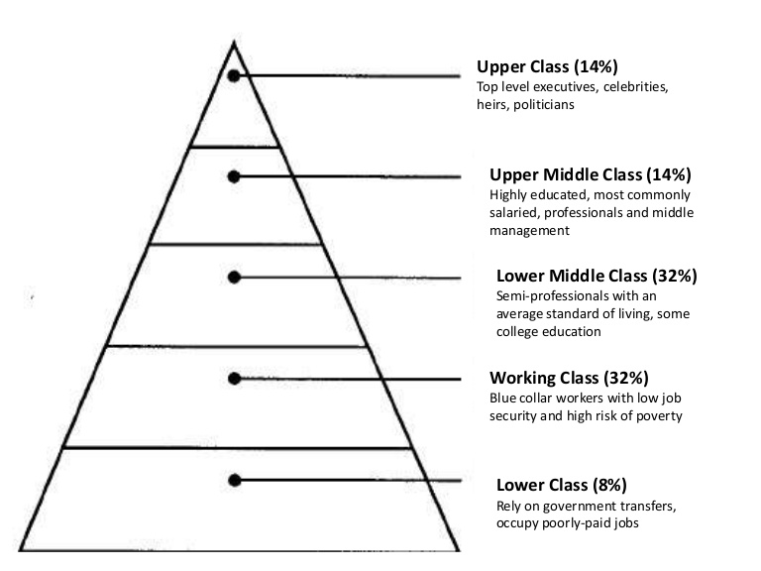
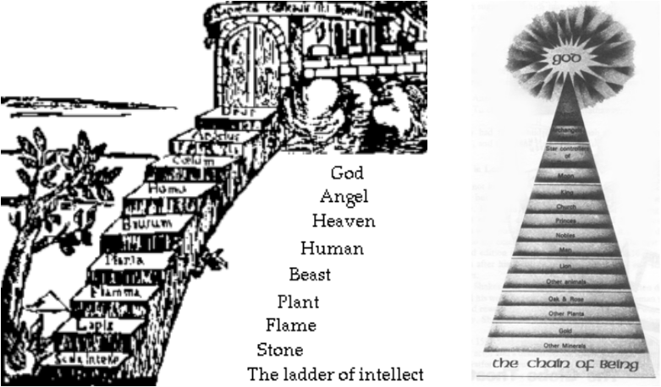
Social Ranking: Order
Caste System
Social Class Pyramid
Great Chain of Being

Slide 7
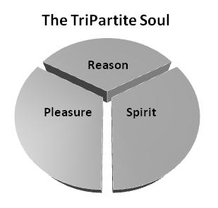
Tripartite Soul
The idea that humans are superior, because they have advanced souls.
→ Mineral Soul (gives ability to reproduce)
→ Animalistic Soul (gives ability to experience emotion and passion)
→ Human Soul (gives ability to reason and maintain a moral and ethical life)

Slide 8
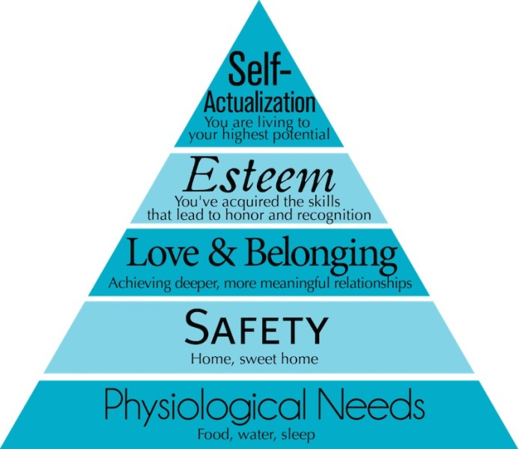
Maslow’s Hierarchy of Needs

Slide 9
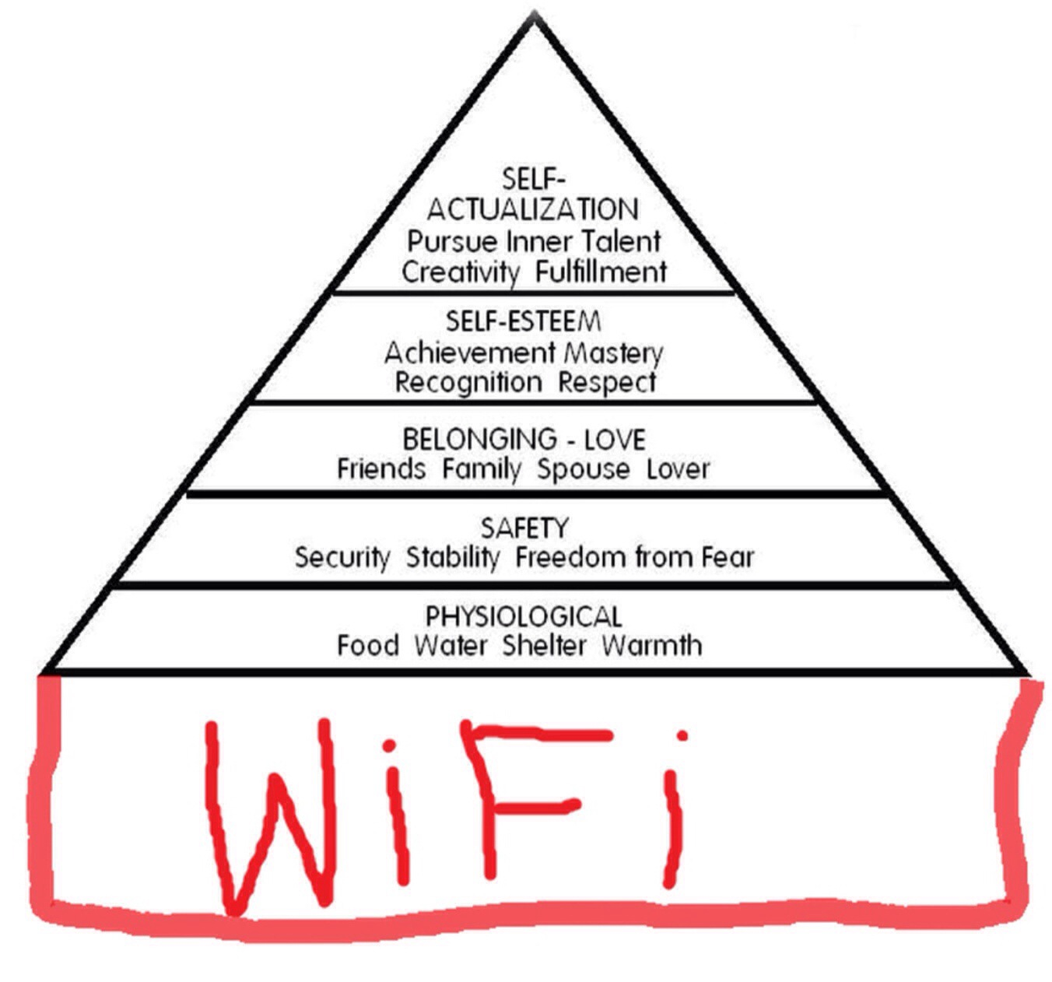
Application to Modernity

Slide 10
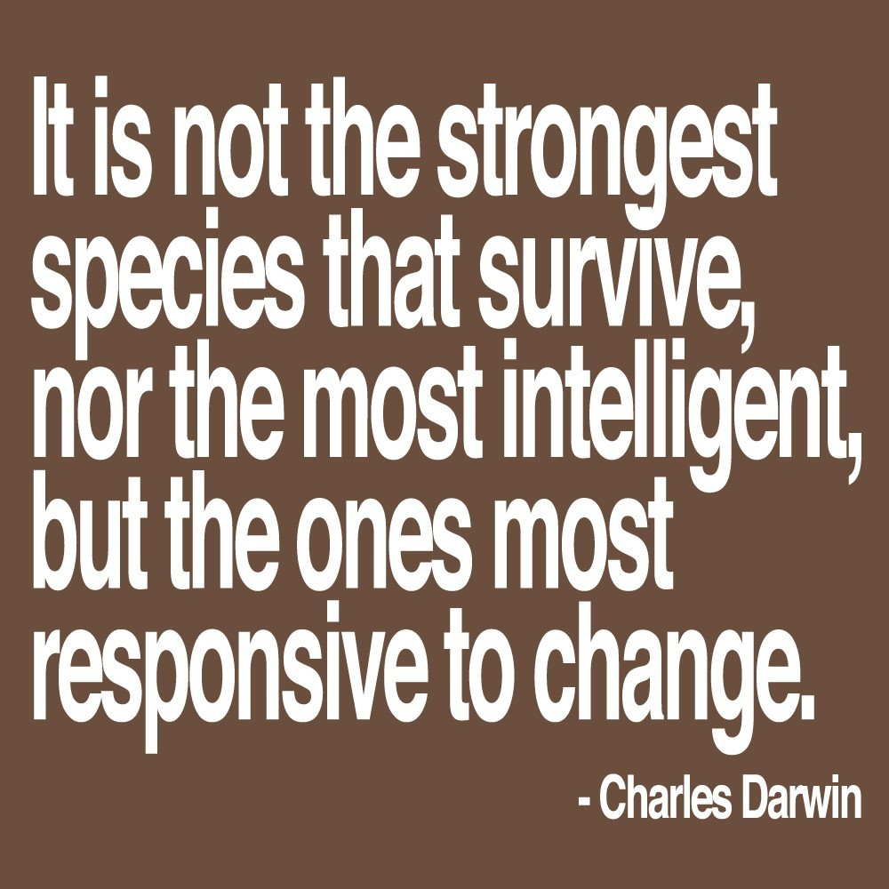
Survival of the Fittest

Slide 11
Survival of the Fittest
“Normally the big cats were not given food one day a week to stimulate conditions in the wild. We found out later that Father had ordered that Mahishna not be fed for three days” (Martel 45).
But on the boat, what is happening?

Slide 12
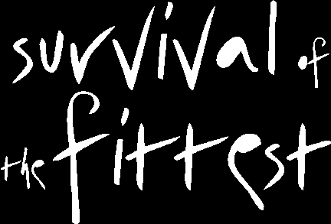
Survival of the Fittest
Sharks
Tiger
Hyena
Human
Orangutan
Zebra

Slide 13
Defying Theory
Refer to page 153

Slide 14
Inherent Altruism
As we read, I want you to look for two instances of altruism.

