Slide 1
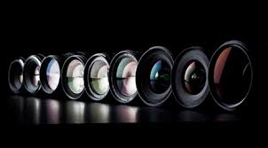
Literary Criticisms
A Brief Overview
Critical Lenses

Slide 2
Archetypal Criticism
Focuses around a set of universal patterns.
Focuses on common symbols and themes in literature.
An archetype is a reference to a concept, a person or an object that has served as a prototype/stereotype of its kind and is the original idea that has come to be used over and over again.

Slide 3
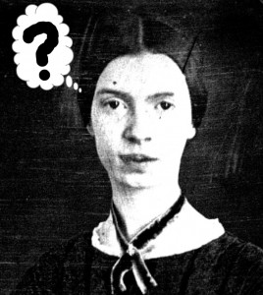
Feminist Criticism
Also tied to Gender & Queer (LGBTQ) Studies
Identifies and studies cultural and economic setbacks in a “patriarchal” society that limit, prevent, or hinder the rights of women or others who identify against the societal gender norms for sex.
Society=
highly patriarchal (males=superior)
Concept:
Women=Passive
Men=Active

Slide 4
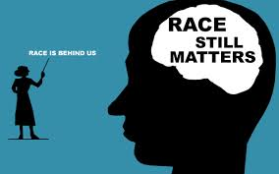
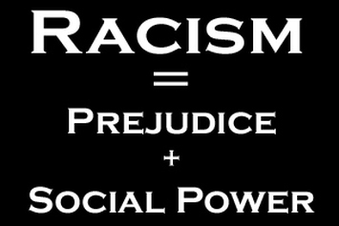
Critical Race Theory
White privilege/ White Supremacy
Hegemony
White individuals influence cultural standards, norms, and thinking… limiting the views of other racial backgrounds

Slide 5
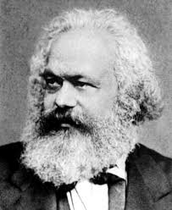
Marxist Criticism
Social class position creates conflicts in the economy, in politics, and social norms
Hegemony

Slide 6
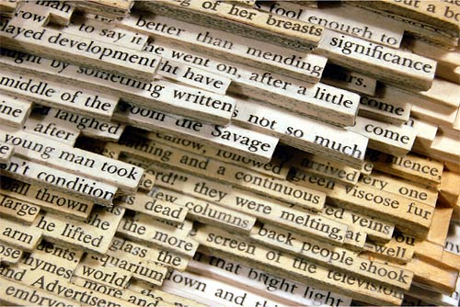
New Criticism/Formalism
Also called FORMALISM.
The text is the ONLY important part of the book.
Everything you need to know can be found through close reading and context clues.

Slide 7
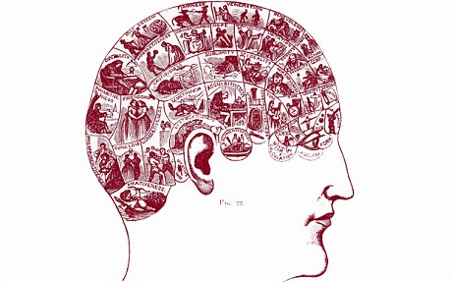
Psychological Criticism
A piece of literature is influenced by the author’s perspective, past experiences, and biases.
Therefore, you must know the author’s background to fully understand the text.

Slide 8
Historical Criticism
Also called New Historicism or Cultural Studies.
A historical critic looks at the time frame and subsequent social propriety (the socio-economic statuses of the time, societal norms, trends, etc.) to better understand the meaning of the text in context with the historical frame. Culture is important.

Slide 9
Postcolonial Criticism
Studies the dynamics of the hegemony (dominance in social status) of Western, first world countries and the effects of colonization.
A post-colonial critic might be studying work from the writers who colonized an area or writers who experienced the cultural changes that came with being colonized.

Slide 10
Literary Criticisms
A Brief Overview
__________ Lenses

Slide 11
____________ Criticism
Focuses around a set of _____________ ______________
Focuses on common __________ and _____________ in literature
An ______________is a reference to a concept, a person or an object that has served as a _______________/_____________ of its kind and is the original idea that has come to be used over and over again.

Slide 12
Feminist __________
Also tied to Gender & LGBTQ Studies
Identifies and studies _________ and ___________ setbacks in a __________ society that ___________, prevent, or hinder the rights of women
Society= highly patriarchal
Male _______________
Concept:
Women=_______________
Men=_______________

Slide 13
Critical ________ Theory
___________ Privilege/ White Supremacy
________________
White individuals influence cultural standards, norms, and thinking… ___________ the views of other ________ backgrounds

Slide 14
___________ Criticism
Social __________ position creates ____________in the economy, in politics, and social norms
Hegemony
Literature reveals the statuses of different social _________ and strains of thoughts

Slide 15
______ Criticism
AKA: _______________
The _________ is the _________ important part of the book
____________ you need to know can be found through close reading and ___________ clues

Slide 16
Psychological Criticism
This theory claims that a piece of literature is influenced by the ______________ perspective, past experiences, and _______.
Therefore, you must know the author’s ___________ to fully ____________ the text.

Slide 17
___________ Criticism
Also called New Historicism or Cultural Studies.
A historical critic looks at the ________________ and subsequent social propriety (the ______________ statuses of the time, societal norms, trends, etc.) to better understand the meaning of the text in context with the historical frame.
________________________.

Slide 18
Postcolonial Criticism
Studies the dynamics of the ____________ (dominance in social status) of Western, first world countries and the ________ of ____________.
A Post-colonial critic might be studying work from the writers who colonized an area or writers who experienced the ___________ __________ that came with being colonized.

