Slide 1
Argumentative Writing
English 9 | New Albany High School

Slide 2
Introduction
Grab the audiences attention!
Options:
1. Ask a rhetorical question to get the audience thinking about your paper.
2. Create an anecdote that really draws in the audience and utilizes pathos to play on the intended audience’s thoughts and feelings.
3. Play up the logical appeal (logos) and integrate statistics and facts that really speak to your argument.

Slide 3
Examples: The Hook
Racism Beyond Black and White
It is Black History month and I am teaching in a Bureau of Indian Education school on the Navajo Reservation. We are studying injustice, racism, and inequity. We are reading great pieces of literature that speak out against the oppressive nature of white privilege. Yet, I have no novels or short stories about Navajos for my students that talk about the same injustice caused by white privilege. In my home state, we think racism is a black and white issue. Why is it that the pervasive belief is that racism is only about hindering the equal rights of Black people in America? Why, once again, have the original people of America been erased in raising awareness and fairness?

Slide 4
Thesis Statement
The thesis statement is the one of the most important parts of the paper. It is the theatrical trailer for the entire paper. It tells the reader what the entire paper will be about.
The best thesis statements are complex sentences with a dependent clause and independent clause.
For Example:
While the underlying belief that racism is only between black and white races, it is essential to understand that injustice is occurring against the indigenous tribes of America in contemporary society today.

Slide 5
The Argument
Topic Sentence: YOUR PERSPECTIVE
Elaboration
Textual Support (Direct Quote) REASON 1
Explanation
Textual Support (Direct Quote) REASON 2
Explanation
Tie Back to Thesis Statement

Slide 6
The Argument
Topic Sentence: YOUR PERSPECTIVE
White Privilege negatively affects Navajo Success
Elaboration
The Navajo People & Demographics in the U.S.
Textual Support (Direct Quote) REASON 1
Social, economic, and academic setbacks on Rez
Explanation
Impact of the Reservation Setup
Textual Support (Direct Quote) REASON 2
Lack of Navajo Writers/Voices in American Education
Explanation
This lack of voice perpetuates the silence that works against liberating Native Americans and ensuring equitable opportunities
Tie Back to Thesis Statement
Racism is thought to be black and white, because no one is talking about Native Americans due to lack of Native American voices and the social, economic, and academic setbacks of the Reservation setup.

Slide 7
Example Argument
(Topic Sentence) Racism hinders the social, economic, and academic advancement of indigenous, Native American tribes within the United States today.
(Elaboration) The Navajo Nation is the largest remaining Native American tribe within the United States. There are a little over 300,000 Navajo people who identify as a part of the tribe according to the Navajo Tribe Census and the United States Census Bureau. Within the United States, that accounts for less than ten percent of the population of the United States. While in 2014, sixty three percent of the American population identified as White and nineteen point five percent identified as Black. Therefore, it is easy to understand why racist treatment towards the Navajo people has been consistently overlooked in current events that raise the negative awareness of white privilege.

Slide 8
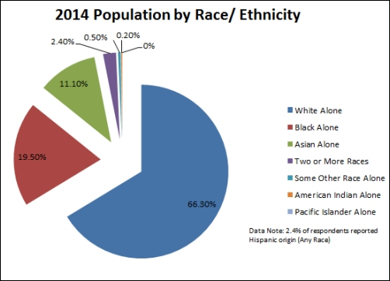
INCLUDE Graphics to Enhance the presentation
http://www.fhgov.com/images/Chart-PopulationbyRaceEthnicity.aspx

Slide 9
Example argument Continued
(Textual Support) According to the Leadership Conference on Civil and Human Rights, “Native Americans suffer from many of the same social and economic problems as other victims of long-term bias and discrimination - including, for example, disproportionately high rates of poverty, infant mortality, unemployment, and low high school completion rates. The struggle for equal employment and educational opportunity is key to addressing these problems” (civilrights.org).
Introduce Quotes
Use in-text citations (website) or (Author Last Name #)

Slide 10
Example argument Continued
(Explanation) Many people fail to realize that the “social and economic opportunities” of the Navajo people are limited due to the Reservation and limited resources there. While the idea of the Reservation and reserving a space for native people is commendable, the living conditions and opportunities on that “reserved” land is immensely flawed. Housing is poor. Many live in Hogans or trailers. Some still do not have running water in the heart of the reservation. In addition, grocery stores are located one to two hours away, making transportation essential in maintaining nutritional needs. In addition, to these limited means of living, the educational systems struggle as well. Students graduate with low literacy levels, making it hard for them to get a college degree. On top of that, those who do leave the Reservation to pursue college, do not often return. Therefore, the lack of resources and the poor educational systems stem from the pervasive influence of white privilege.

Slide 11
Example argument Continued
(Textual Support) Something along the lines of why there are not many Native American voices in literature and in American classrooms
(Explanation) Etc.
(Tie Back to Thesis) Racism is thought to be black and white, because no one is talking about Native Americans due to lack of Native American voices and the social, economic, and academic setbacks of the Reservation setup.

Slide 12
The Counterargument
Introduce the argument that works against your side of the debate. Then, have a come back ready to go.
Topic Sentence
Elaboration
Textual Support
Explanation
Tie Back to Thesis

Slide 13
The Counterargument
Introduce the argument that works against your side of the debate. Then, have a come back ready to go.
Topic Sentence
Elaboration
Textual Support
Explanation
Tie Back to Thesis

Slide 14
Counterargument Example
(Topic Sentence) While many people blame the Navajo people for not taking initiative in their own situations, it is pertinent to note that such accusations further disempower the Navajo people.

