Slide 1
A Mid-Summer Night’s Dream William Shakespeare 1600

Slide 2
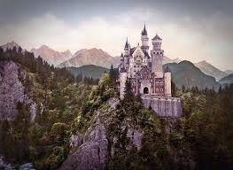
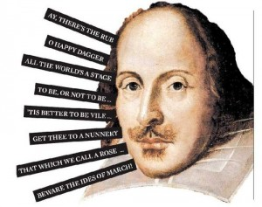
Fairytale Archetypes
The Castle
The Magic Forest
Fairies
Magic
True Love
Happily Ever After

Slide 3
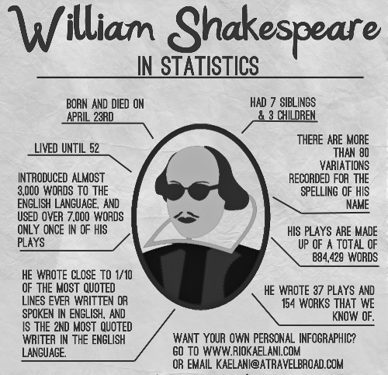
William Shakespeare

Slide 4
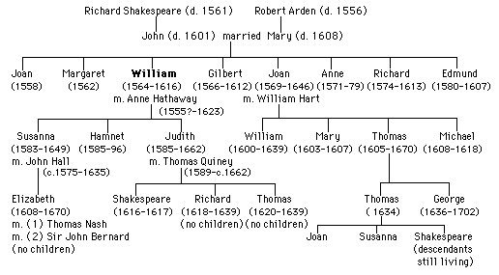
Shakespeare Family Tree

Slide 5
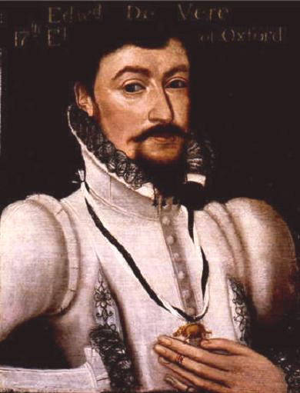
Or was it Edward de Vere
Some individuals and scholars of Shakespeare believe that the true author of these works was Edward de Vere.
However, since an actor and playwright was not an acceptable profession for a member of the aristocracy, de Vere could not use his own name.

Slide 6
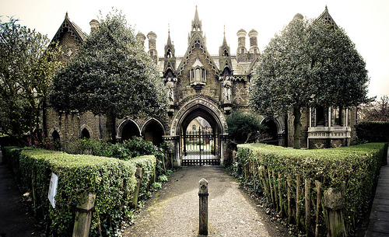
A Land Far Away

Slide 7
The Setting

Slide 8
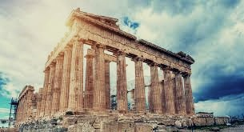
The Setting Continued
Theseus is Duke of Athens. Our setting takes place in the woods near the city of Athens.
Once in the woods, a series of magical and dream like event unravel.

Slide 9
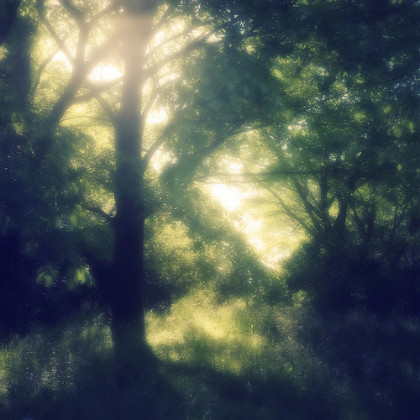
A Magical Forest

Slide 10
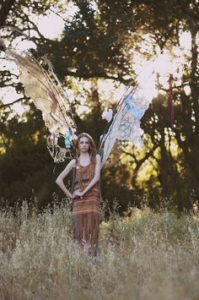
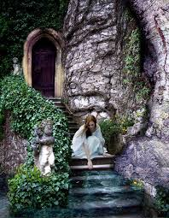
We’ve got some fairies

Slide 11
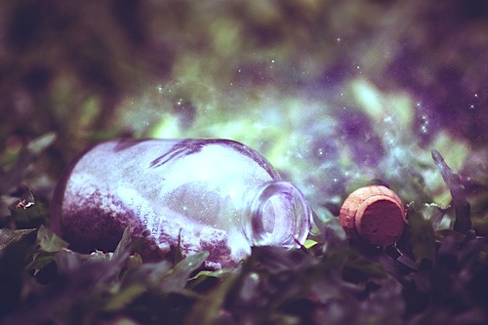
And Love Juice…

Slide 12
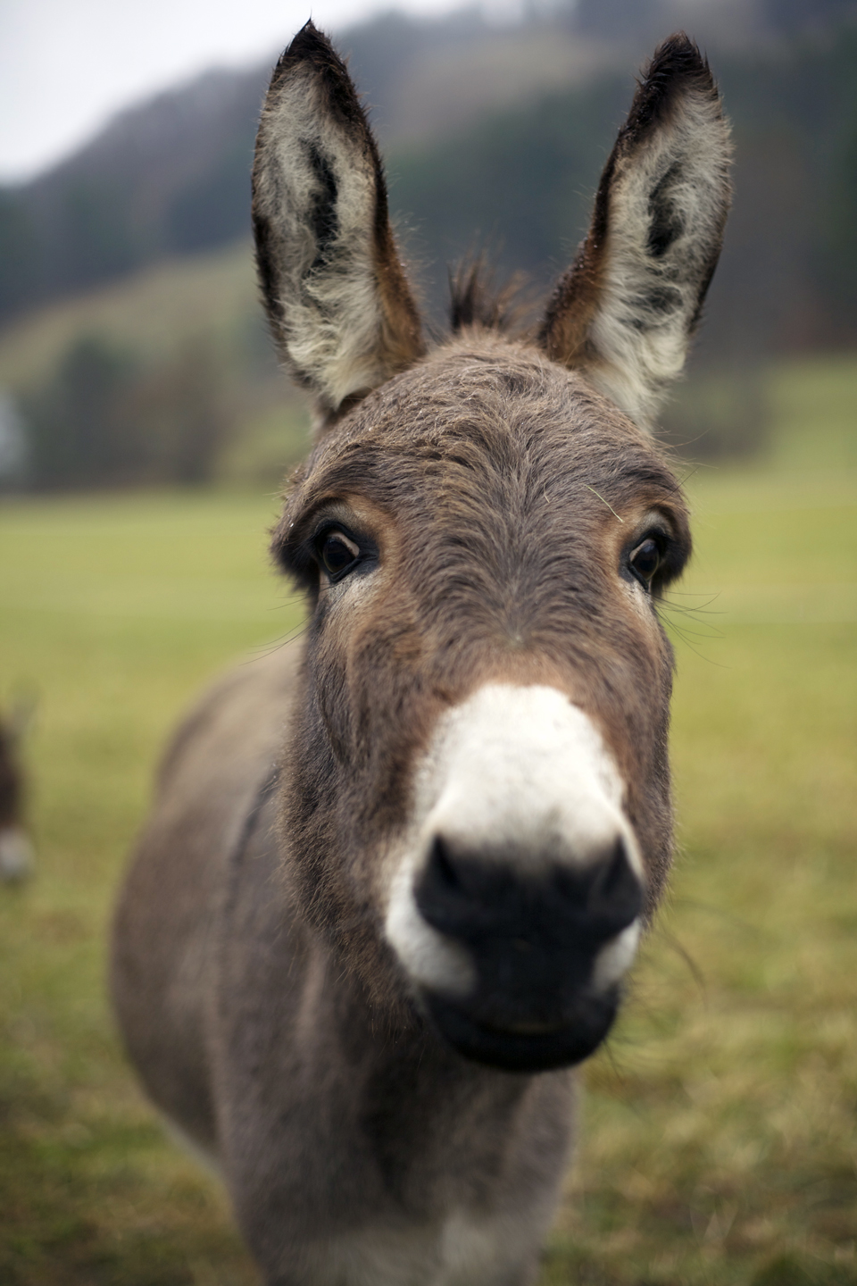
Oh, and a donkey.

Slide 13
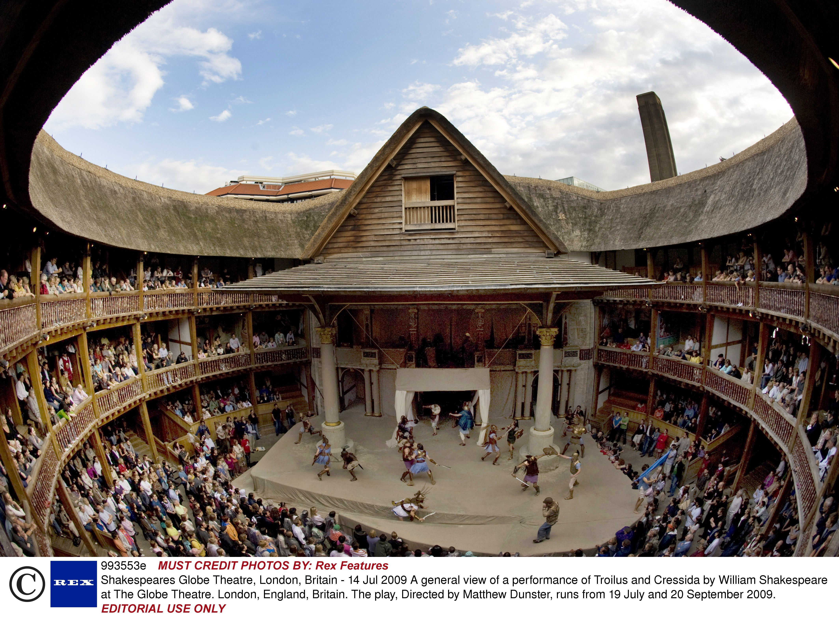
The Globe Theatre

Slide 14
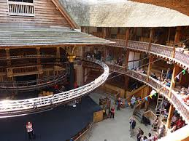
The Globe Theatre

Slide 15
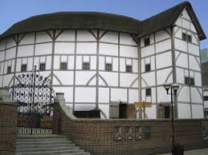
The Globe Theatre

